Slide 1


H₂O Quick Start

Slide 2

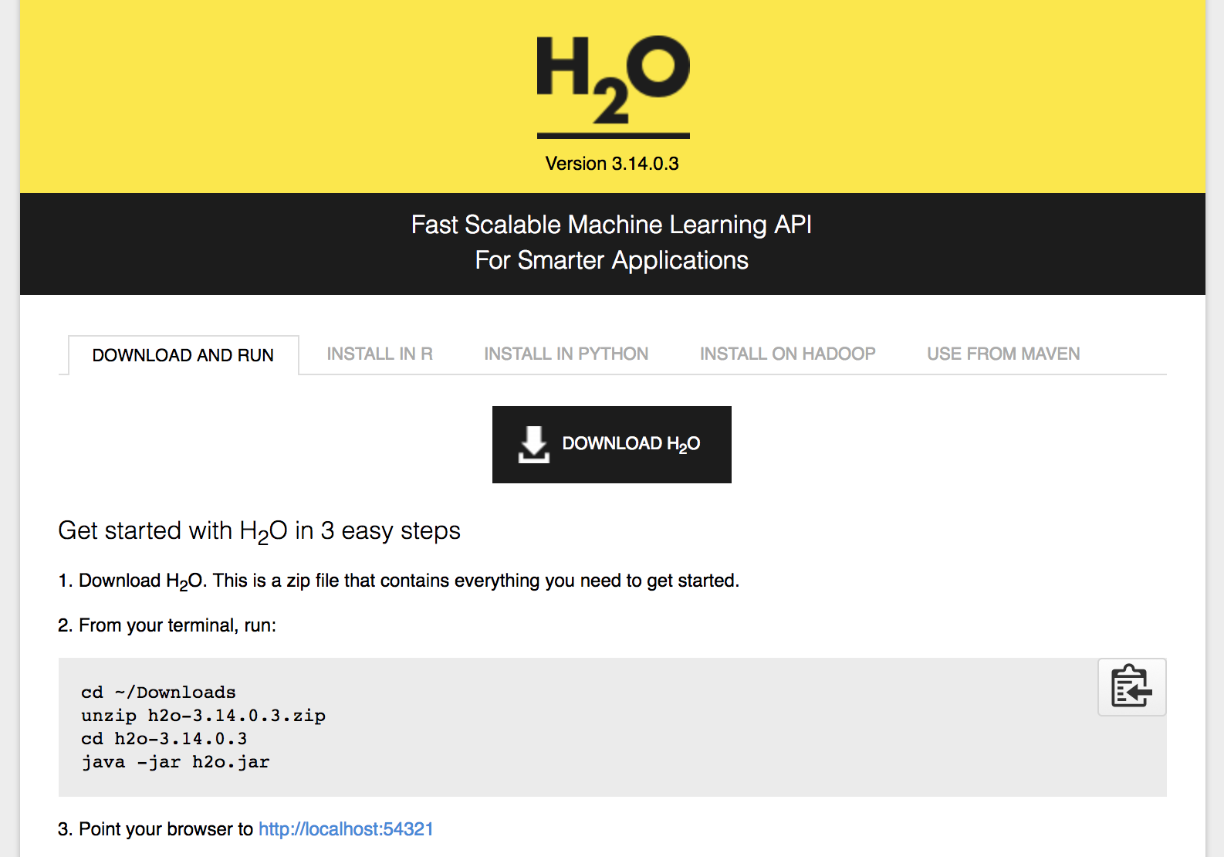
www.h2o.ai/download
Prerequisite: Java version 7 or 8
(Note: Java version 9 is not yet supported)

Slide 3

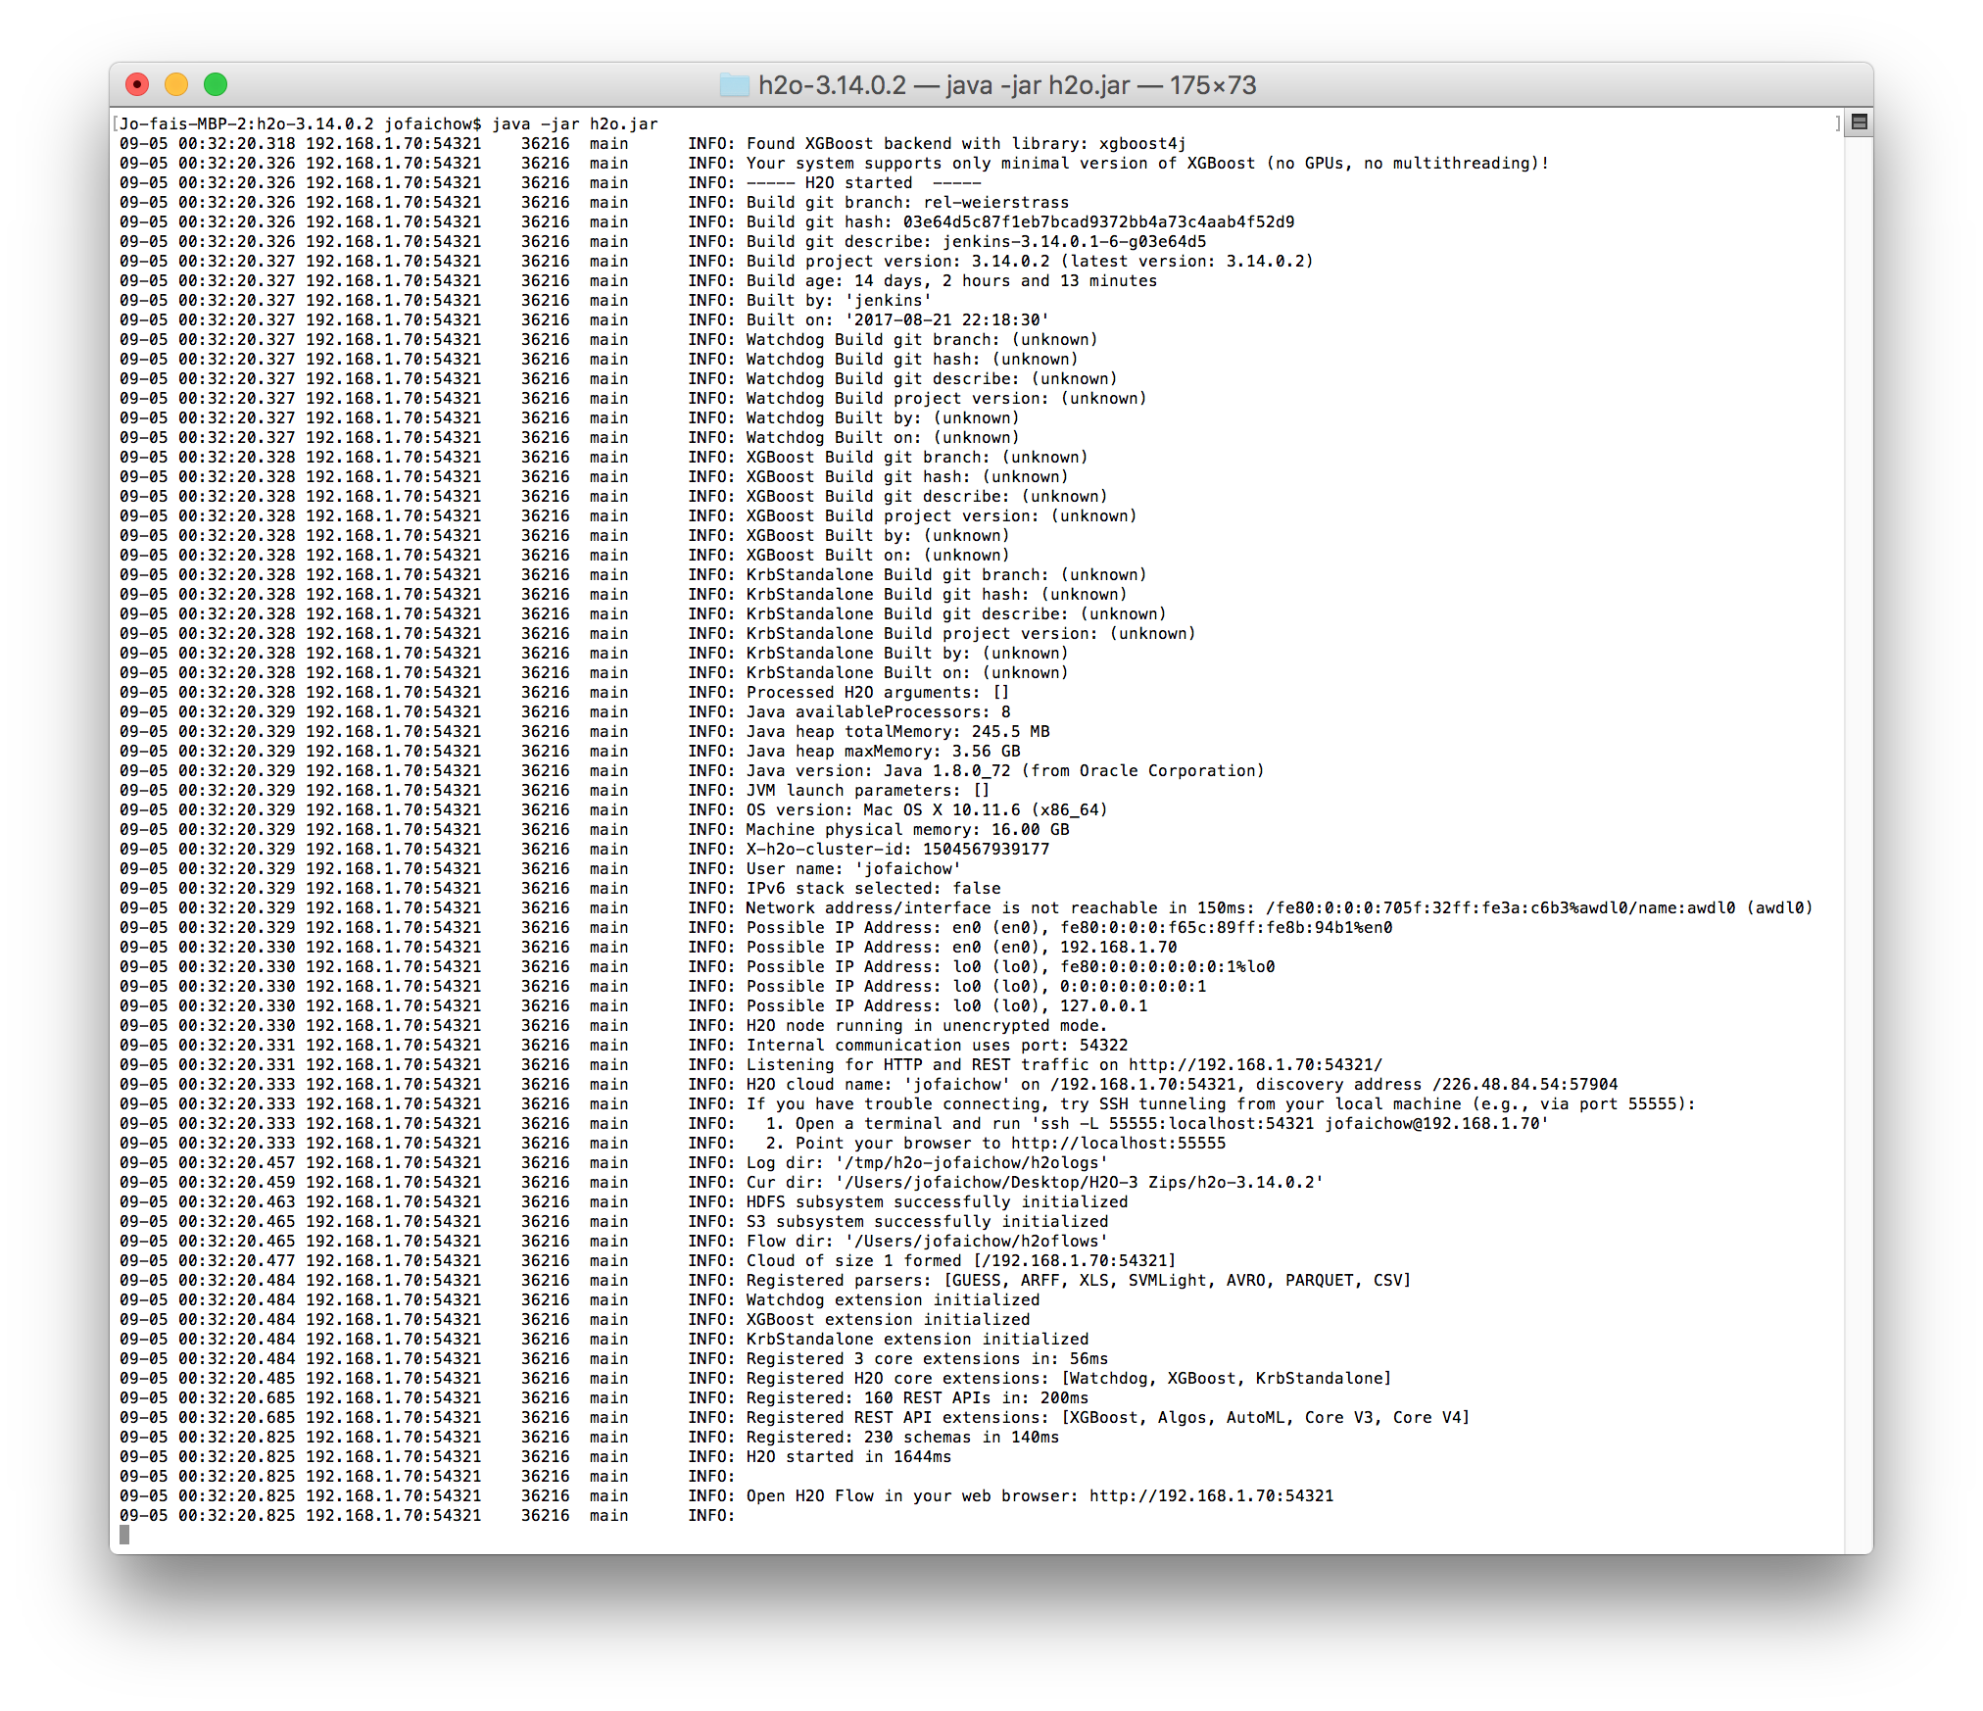
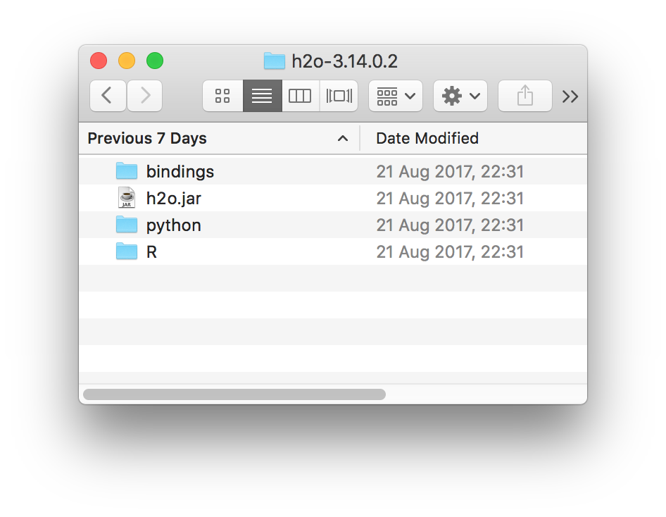
Install and Start H₂O Flow (Web Interface)

Slide 4
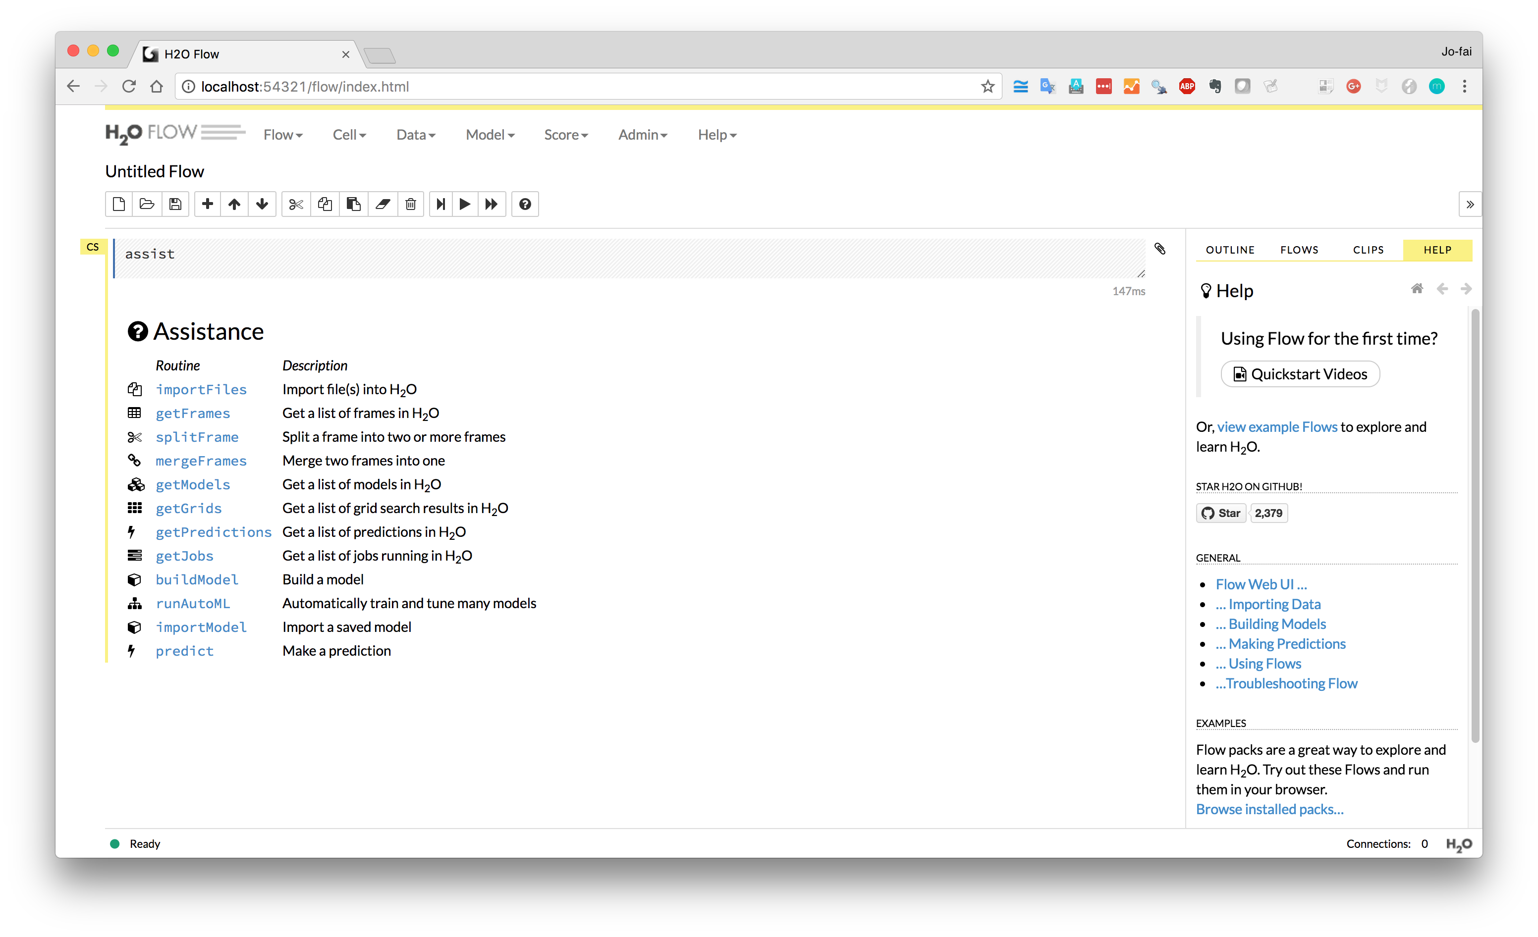
H₂O Flow (Web Interface)
More Examples

Slide 5
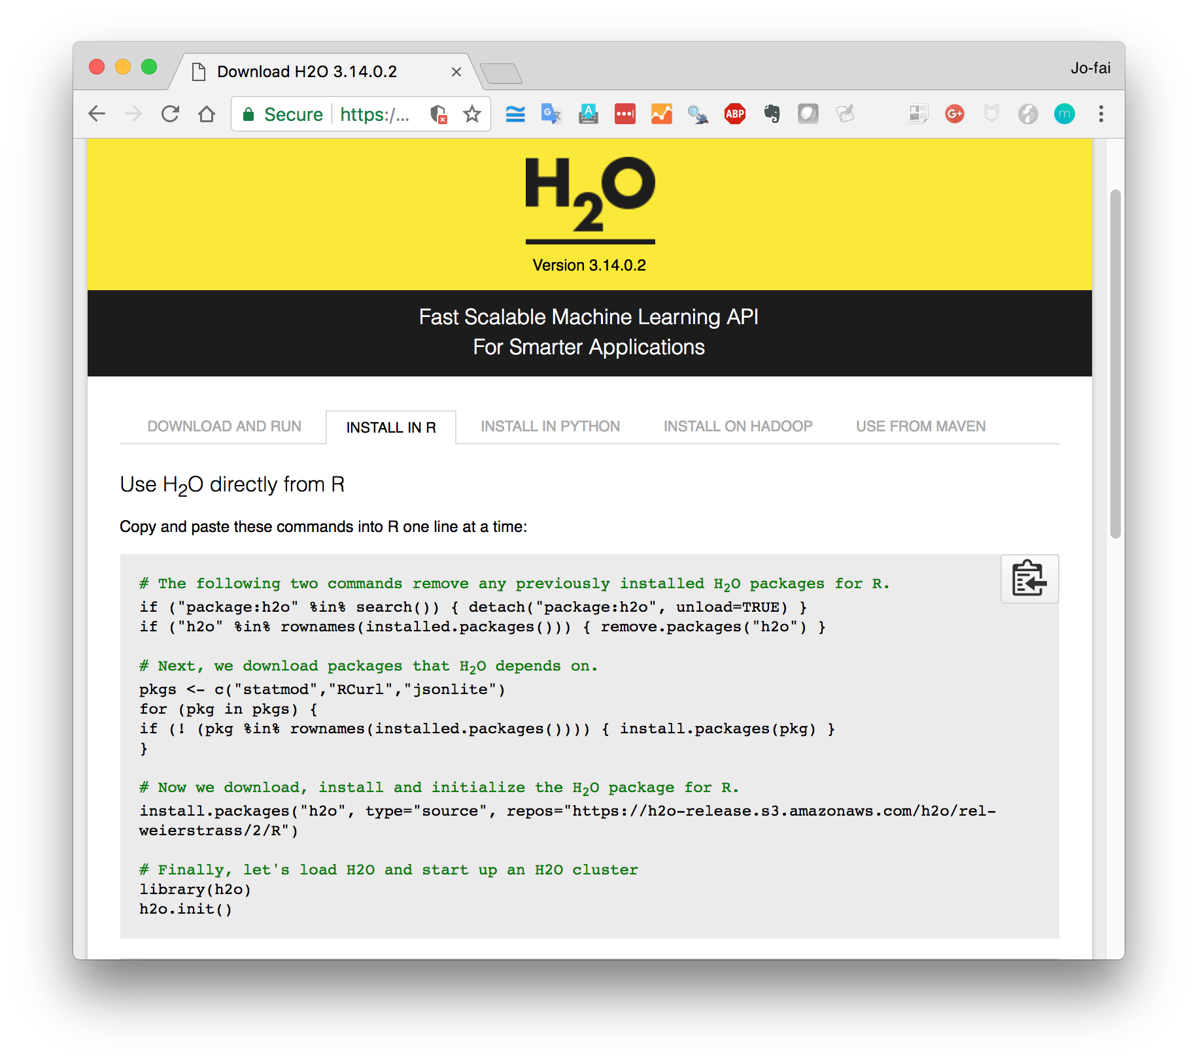
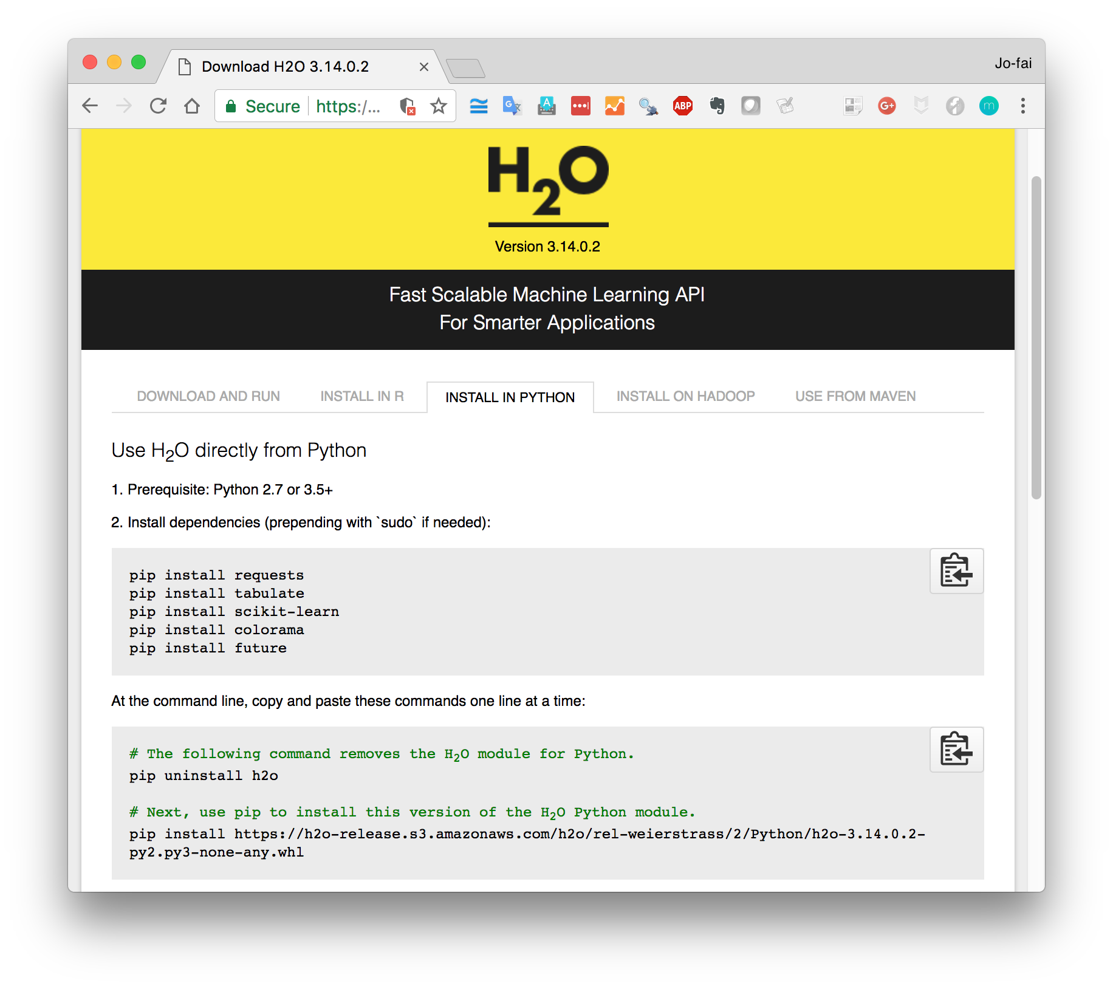
Install and Start H₂O in R / Python

Slide 6

Hands-on: Regression
Data: Boston Housing (1978)
Source: http://www.cs.toronto.edu/~delve/data/boston/bostonDetail.html

Slide 7
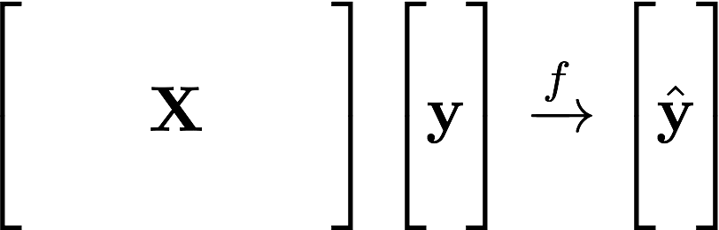
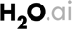
Supervised Learning Example
Machine Learning:
Learn Patterns
from Data
Historical Data:
No. of Rooms
Crime Rate
Pupil-Teacher Ratio
…
Target:
House Value
Predicted Value

Slide 8
Supervised Learning – You Already Have Target Data
Regression:
How much will a customers spend?
Classification:
Will a customer make a purchase? Yes or No
yes
no
y
x_{j}
X
x_{i}
H₂O algos:
Penalized Linear Models
Random Forest
Gradient Boosting
Neural Networks
Stacked Ensembles
H₂O algos:
Penalized Linear Models
Naïve Bayes
Random Forest
Gradient Boosting
Neural Networks
Stacked Ensembles

Slide 9
Regression – Key Steps
Import Data (CSV Files)
./data/regression/ …
Have a quick look
Train a Random Forest Model
Look at variable importance
Make Predictions
Compare with ground truth
Build Partial Dependence Plots
Explain model behaviour

Slide 10
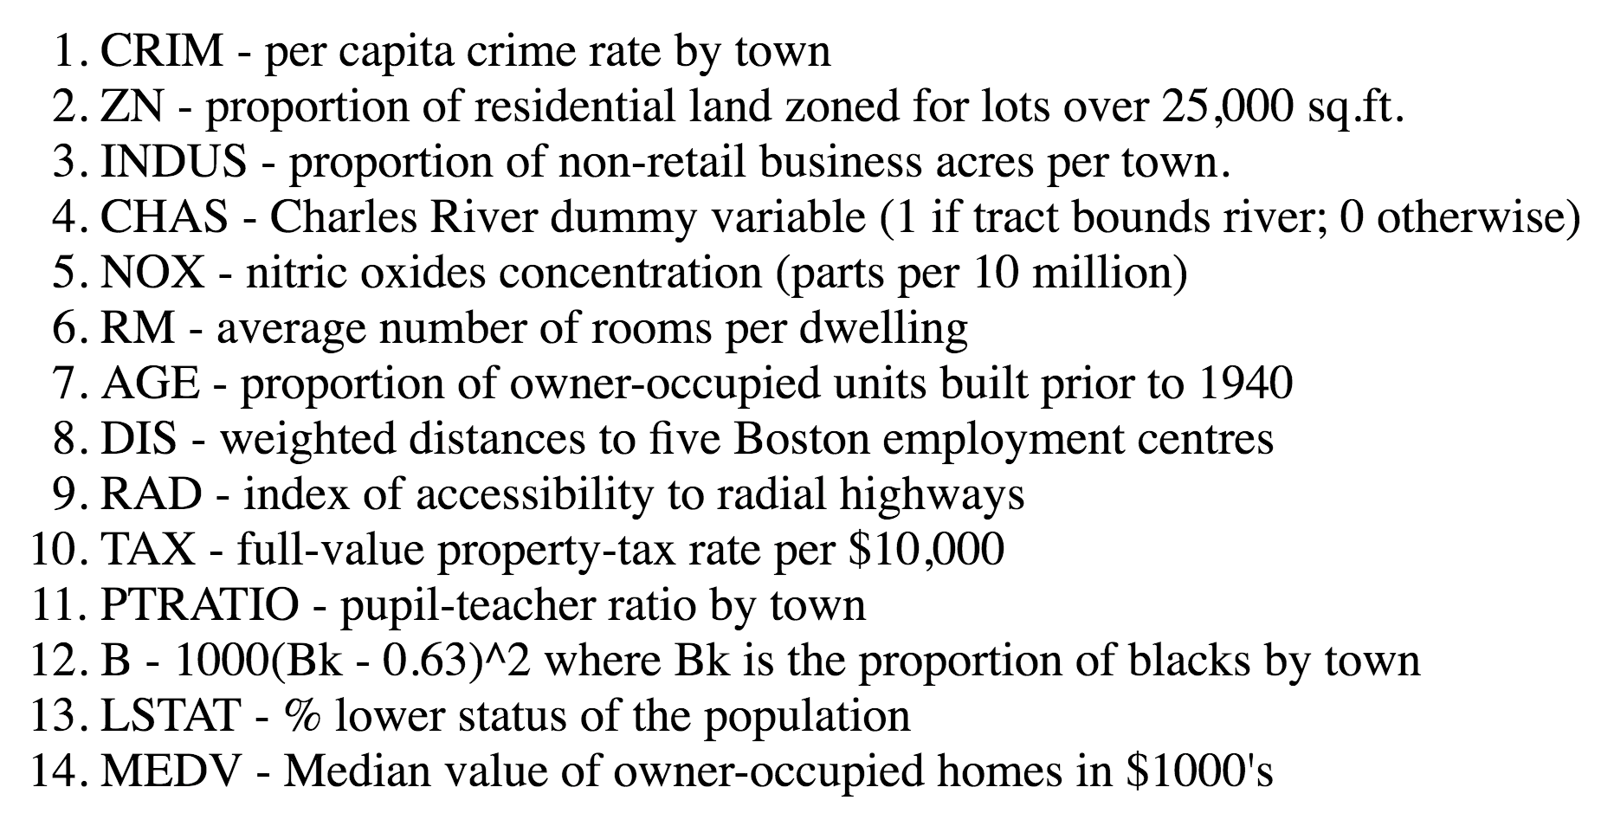
Target:
House Value

Slide 11
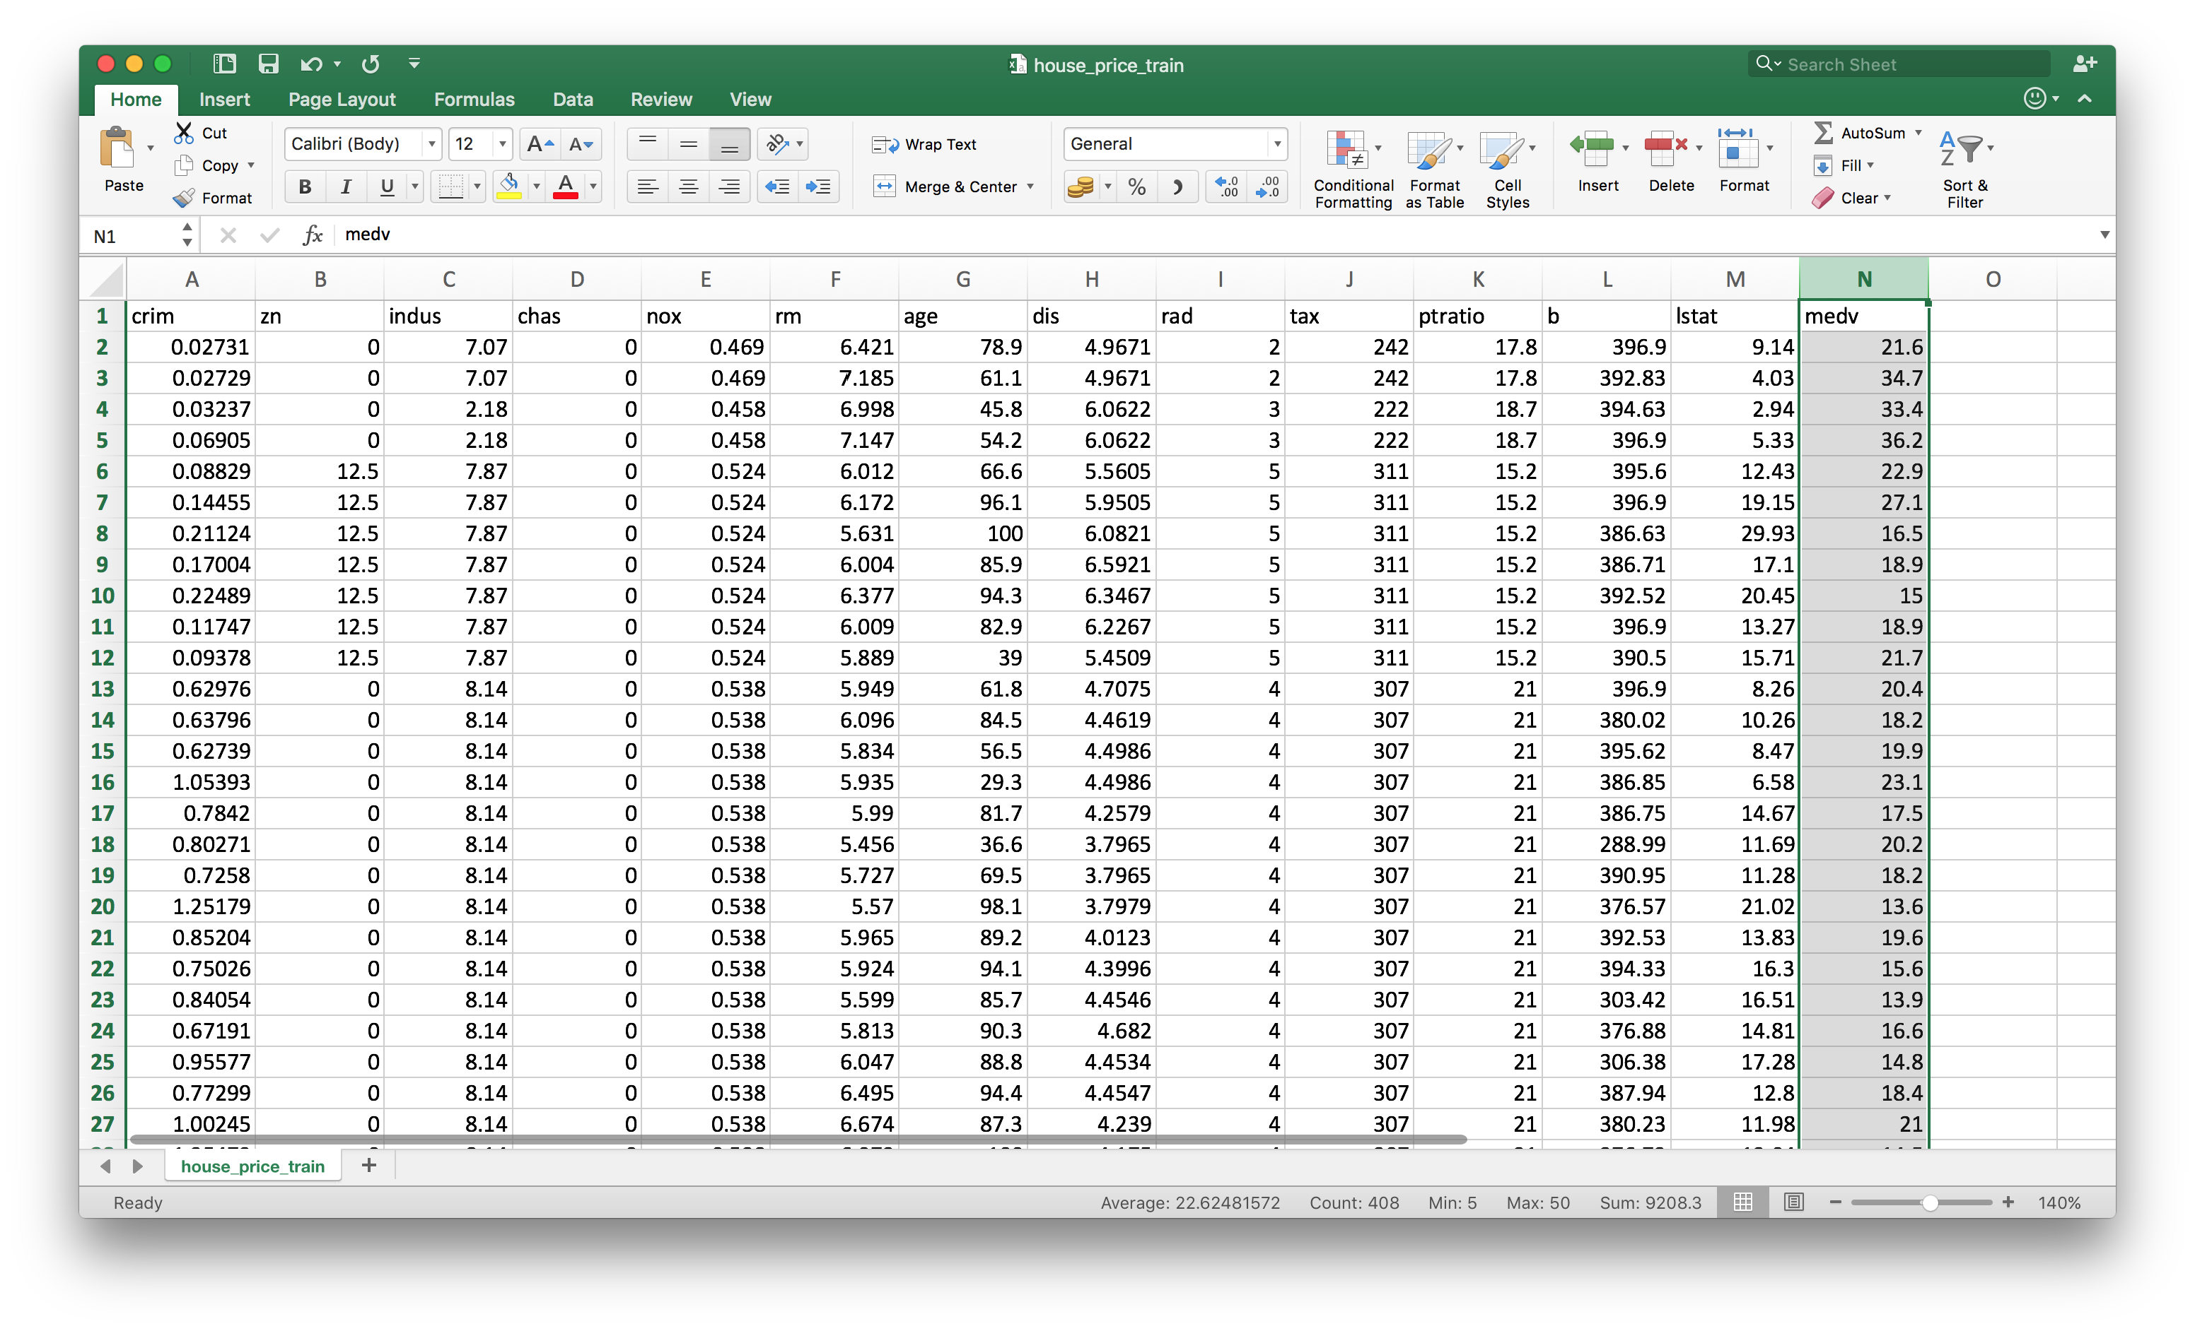
../..regression/
house_price_train.csv

Slide 12
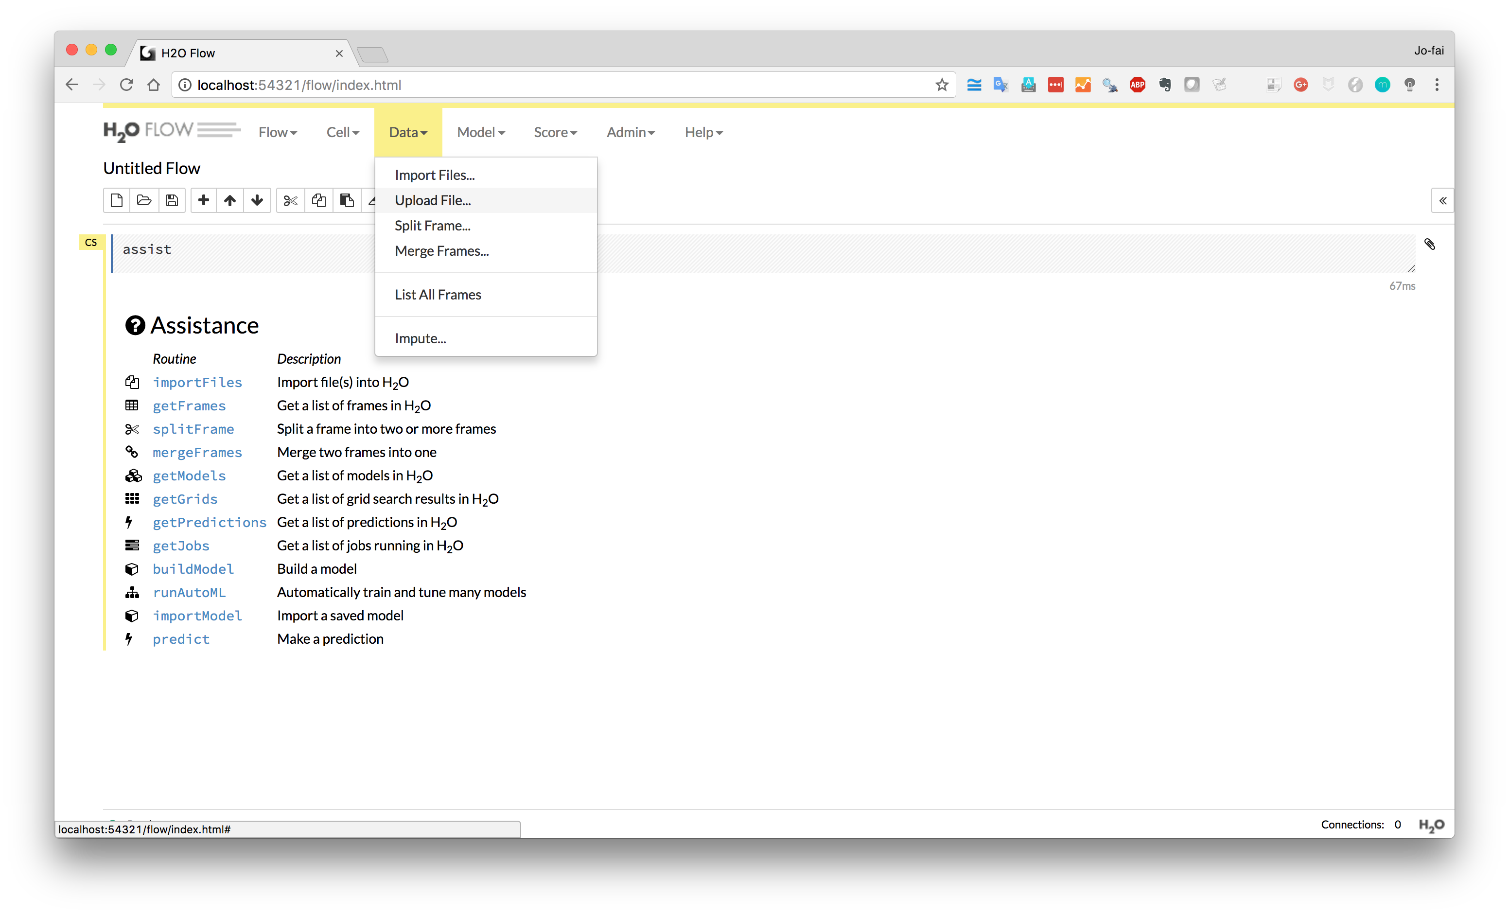
Data → Upload File …

Slide 13
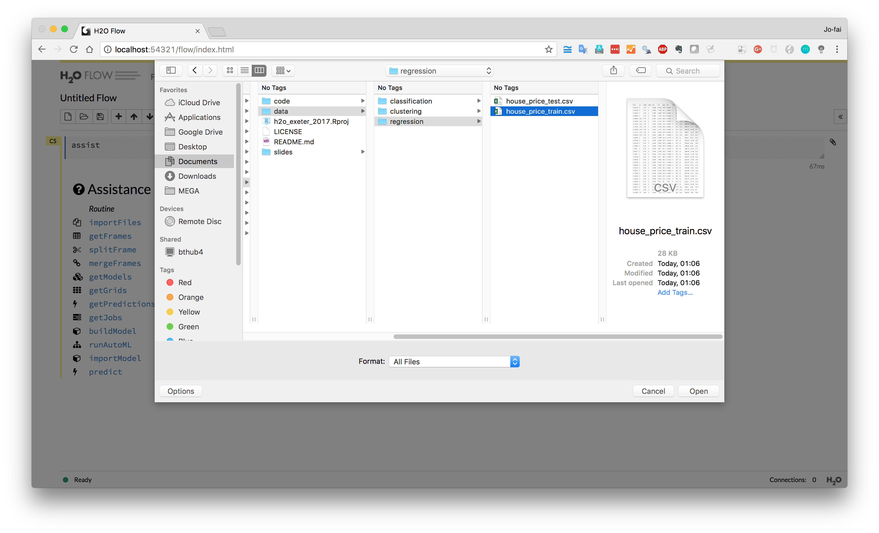

Slide 14
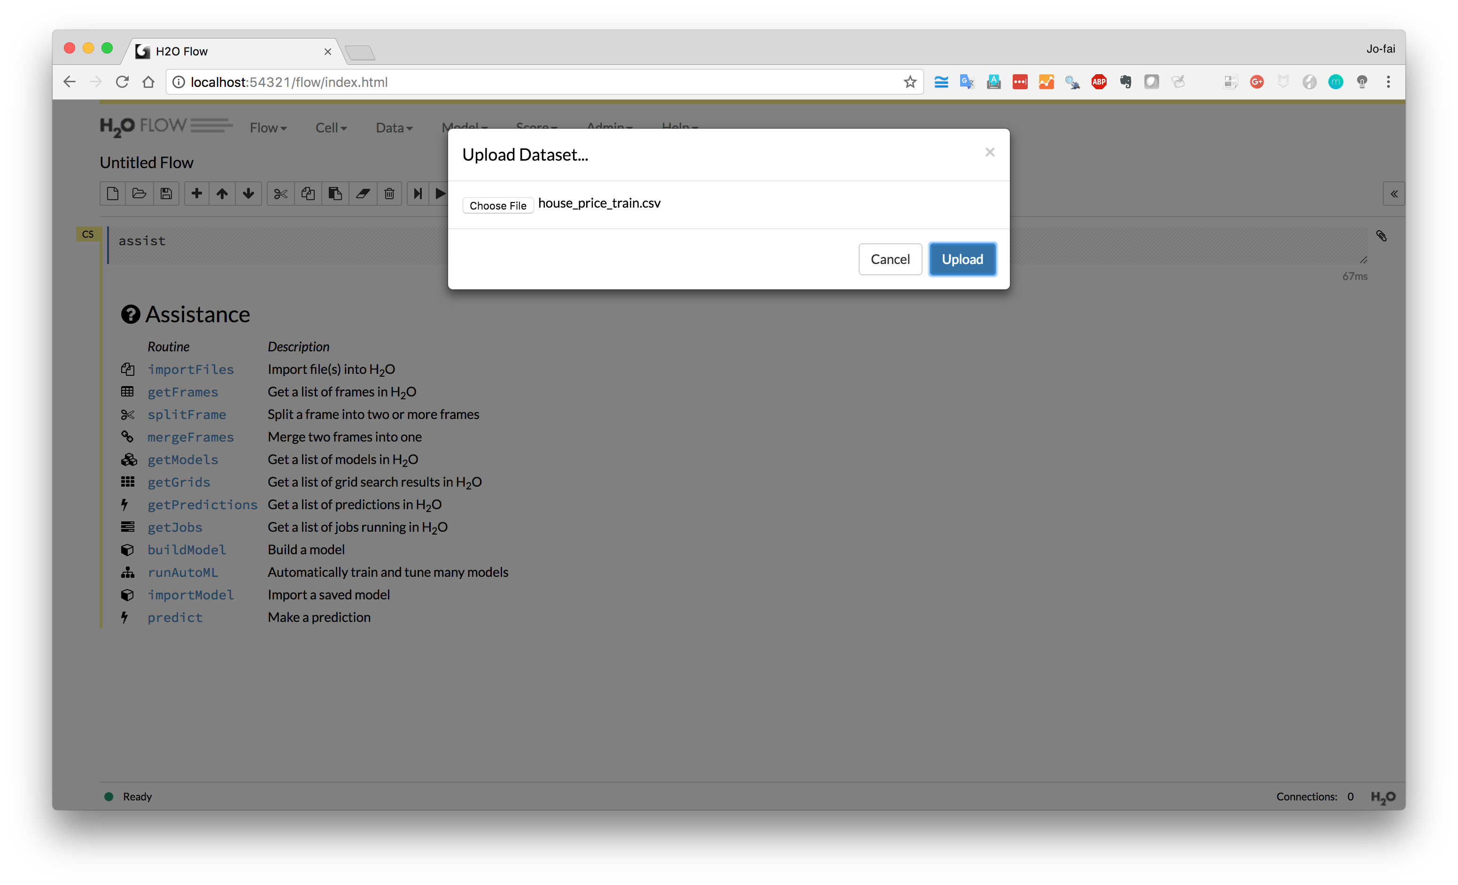
Upload

Slide 15
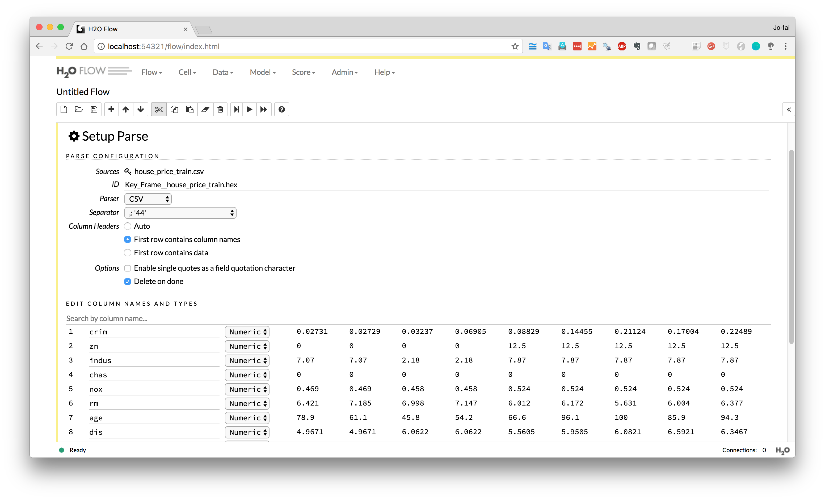
Scroll down

Slide 16
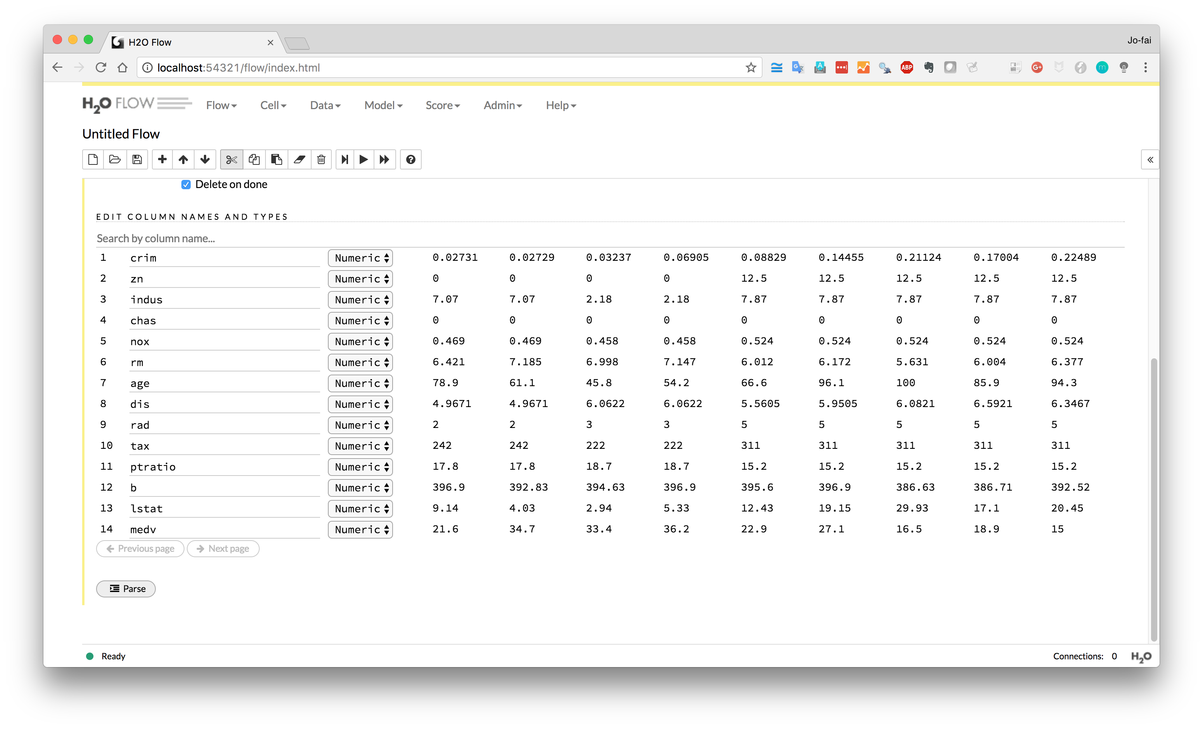
Click ”Parse”

Slide 17
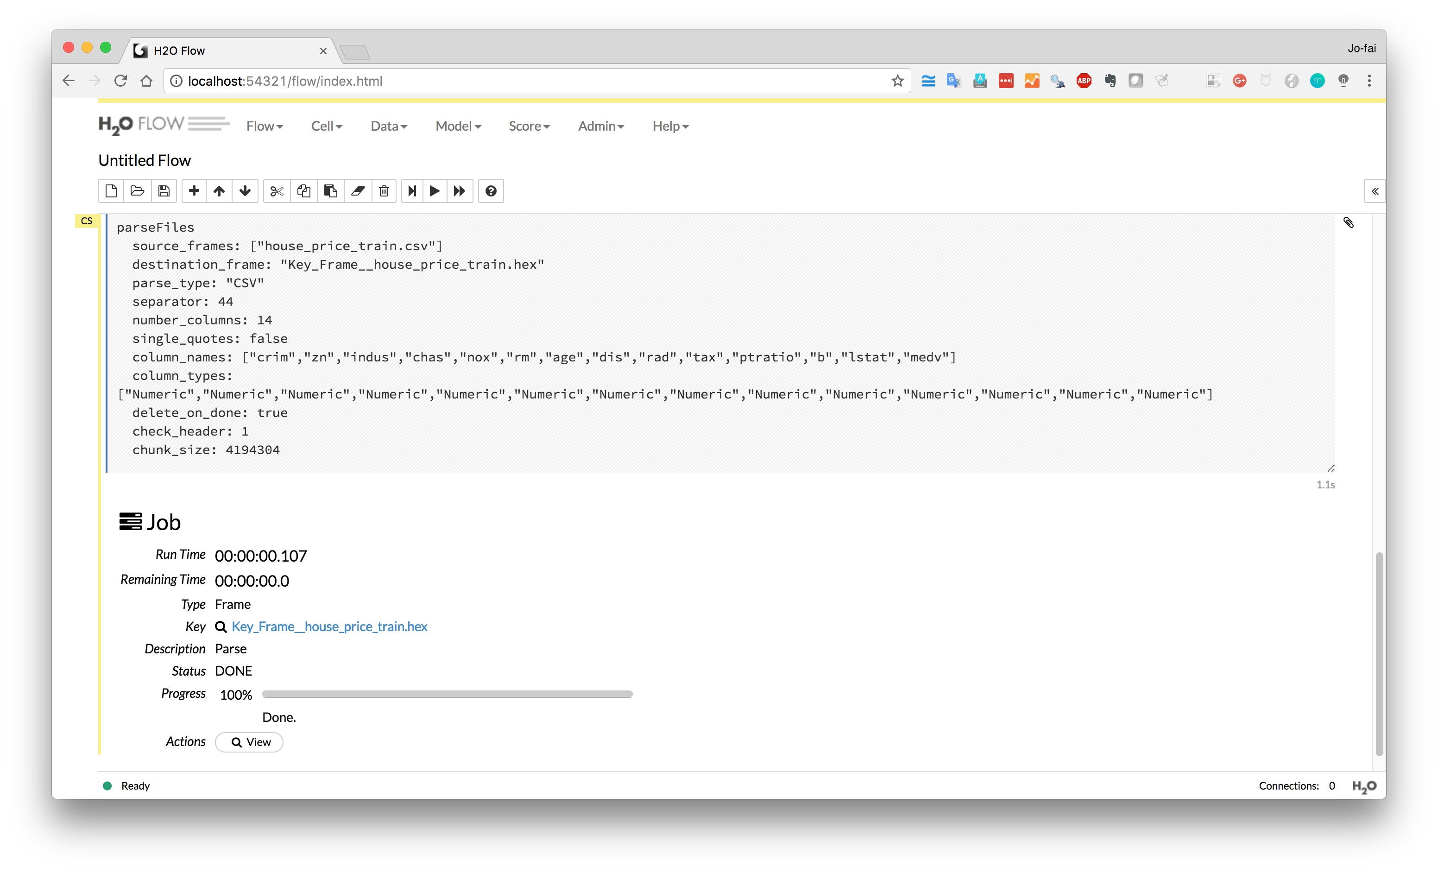
Click “View”

Slide 18
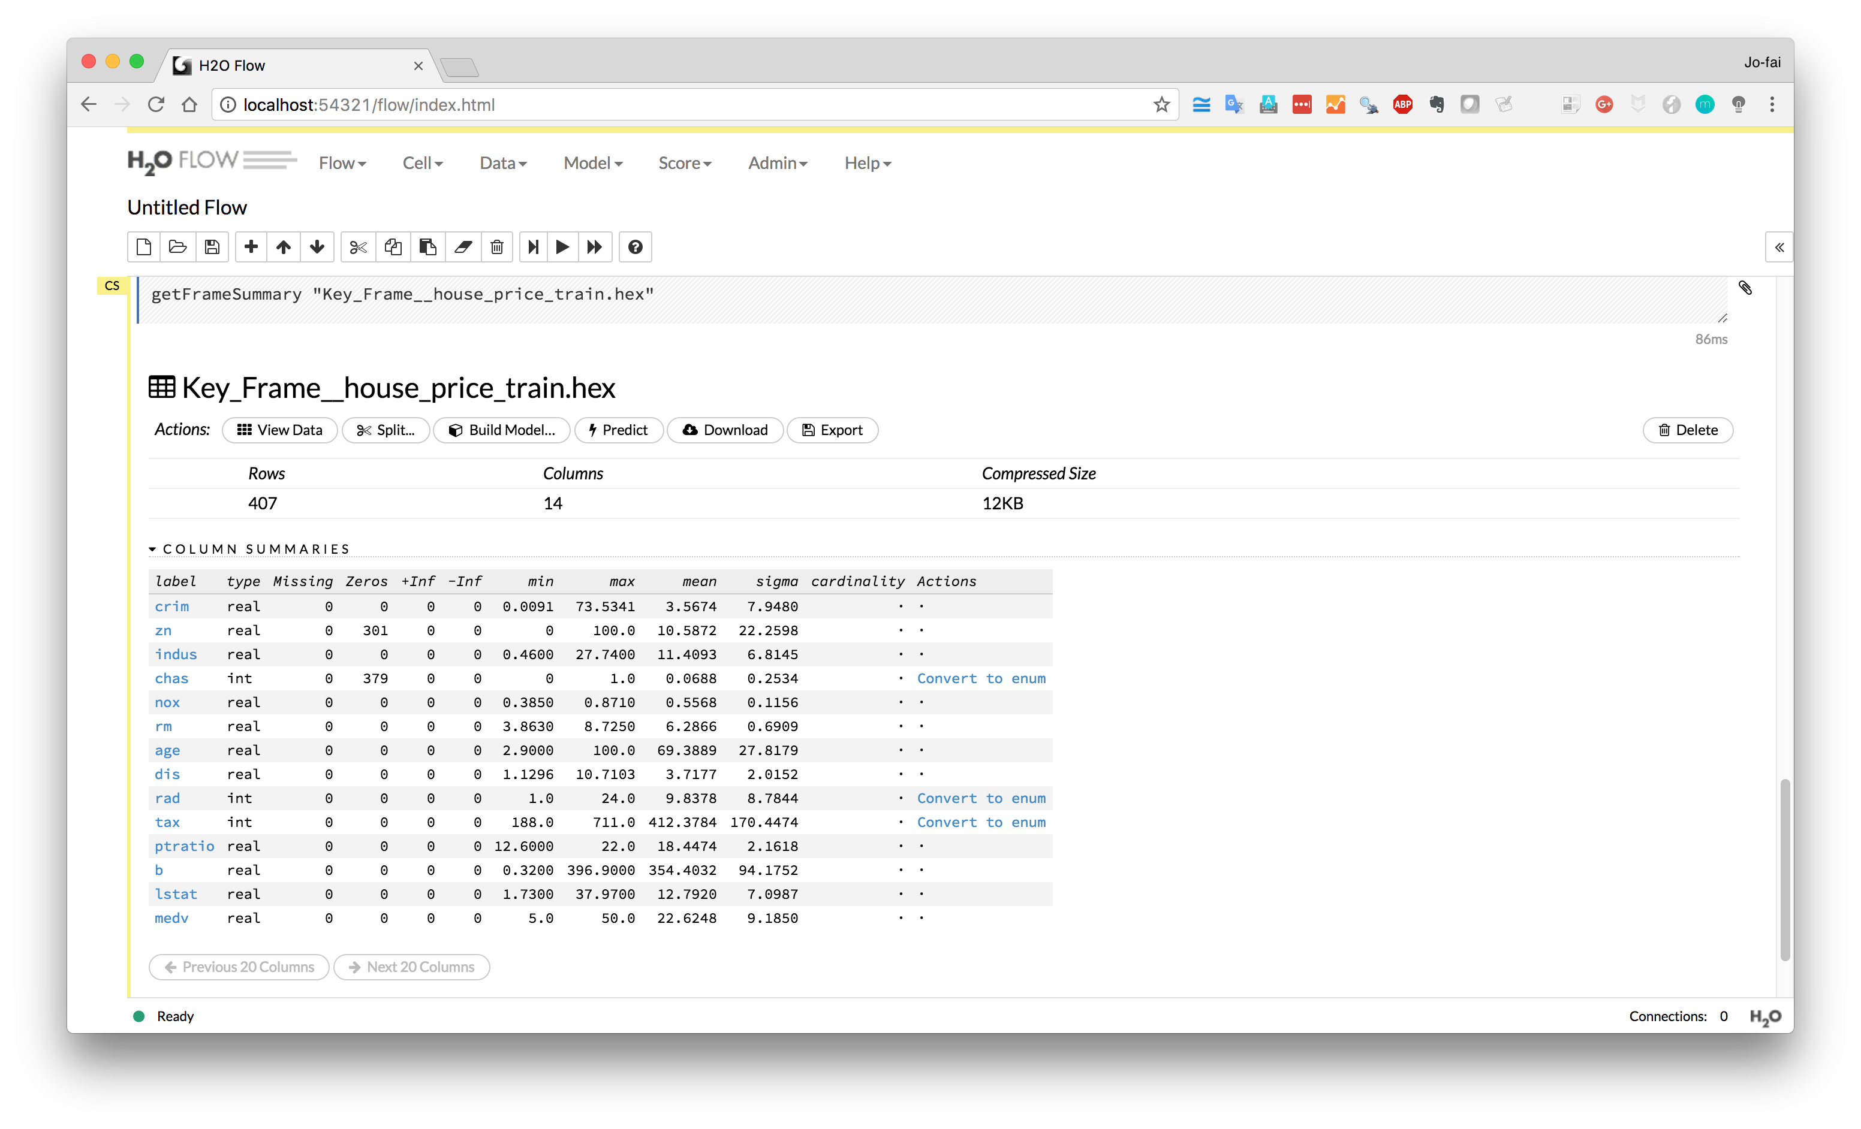
Click on any variable
e.g. crim, medv

Slide 19
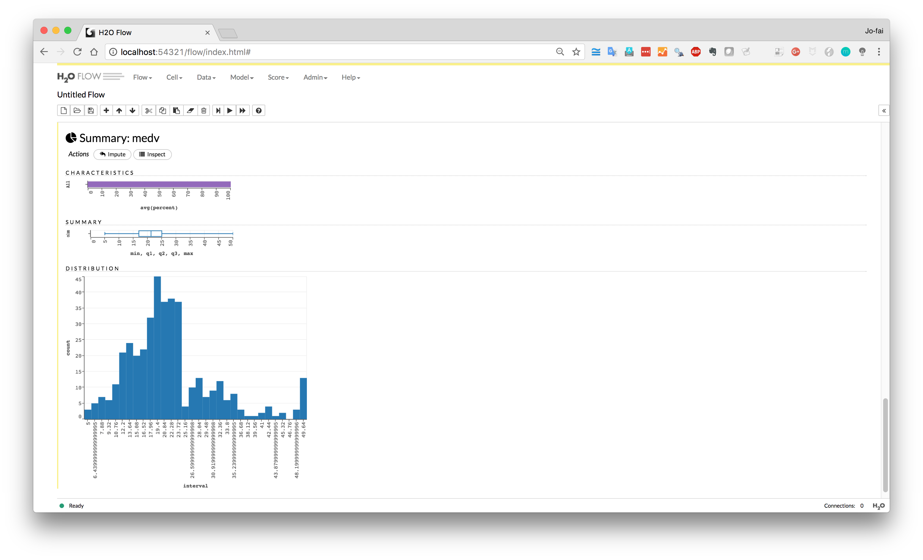
Some basic visualisation for
quick exploratory analysis

Slide 20
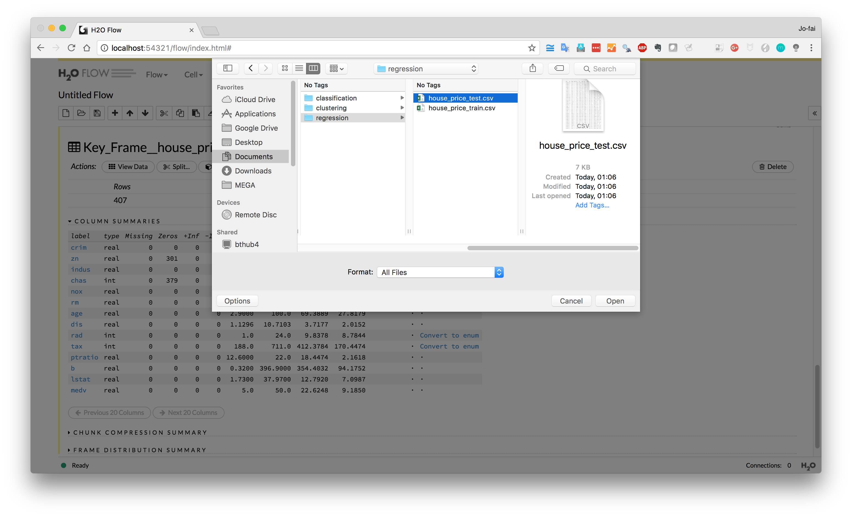
Now do the same for
house_price_test.csv
(e.g. new data for making predictions)

Slide 21
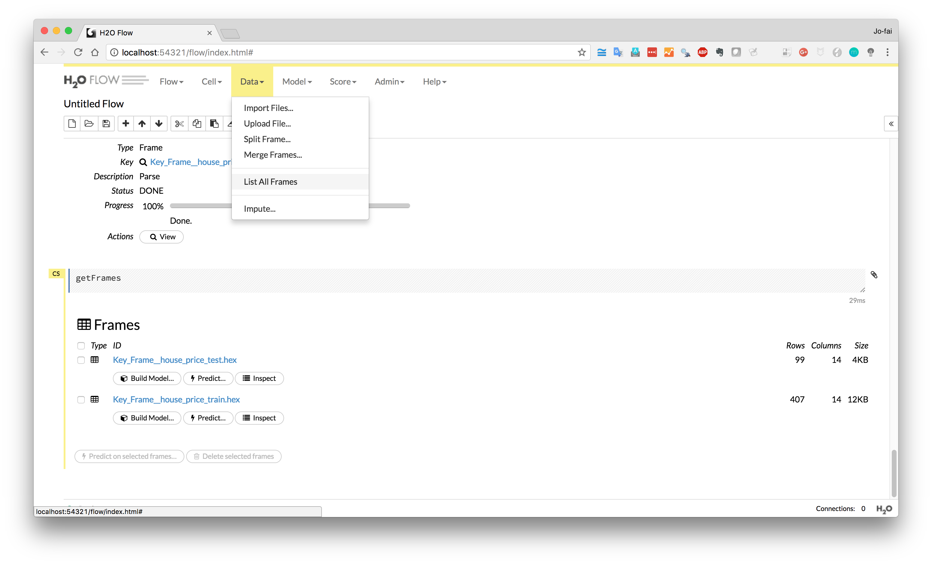
Show all data
Data → List All Frames

Slide 22
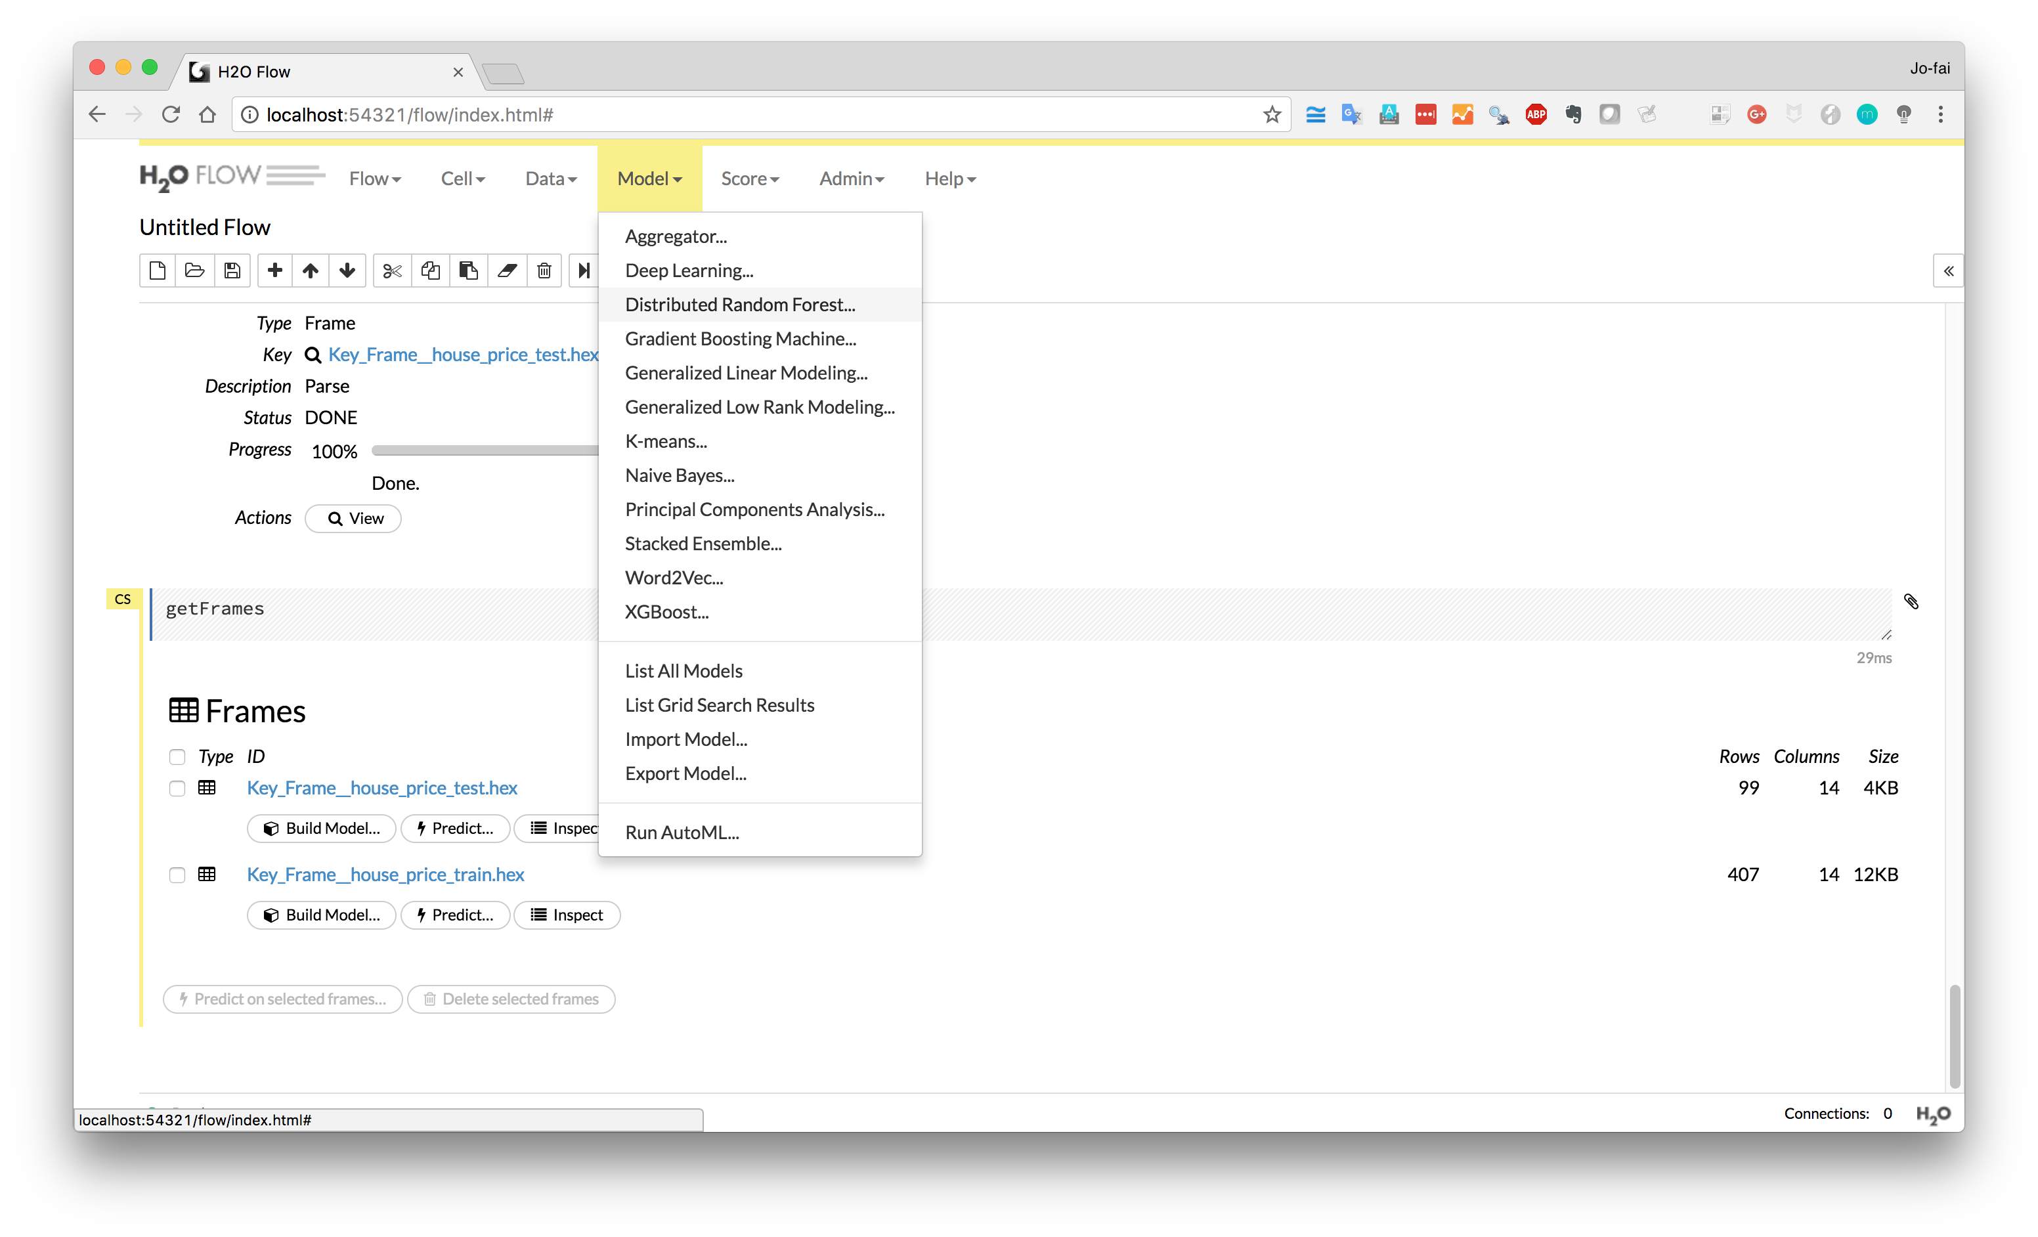
Train a predictive model
Start with Random Forest

Slide 23
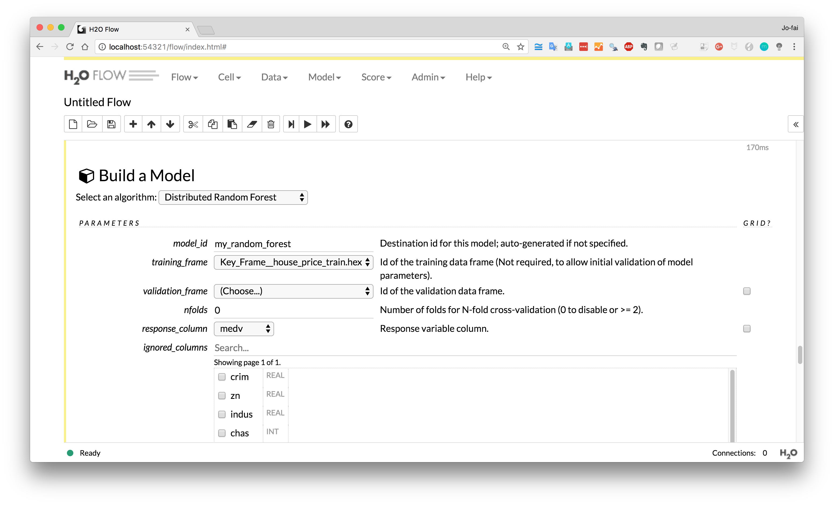
1) Choose “house_price_train”
2) Select “medv” as response

Slide 24
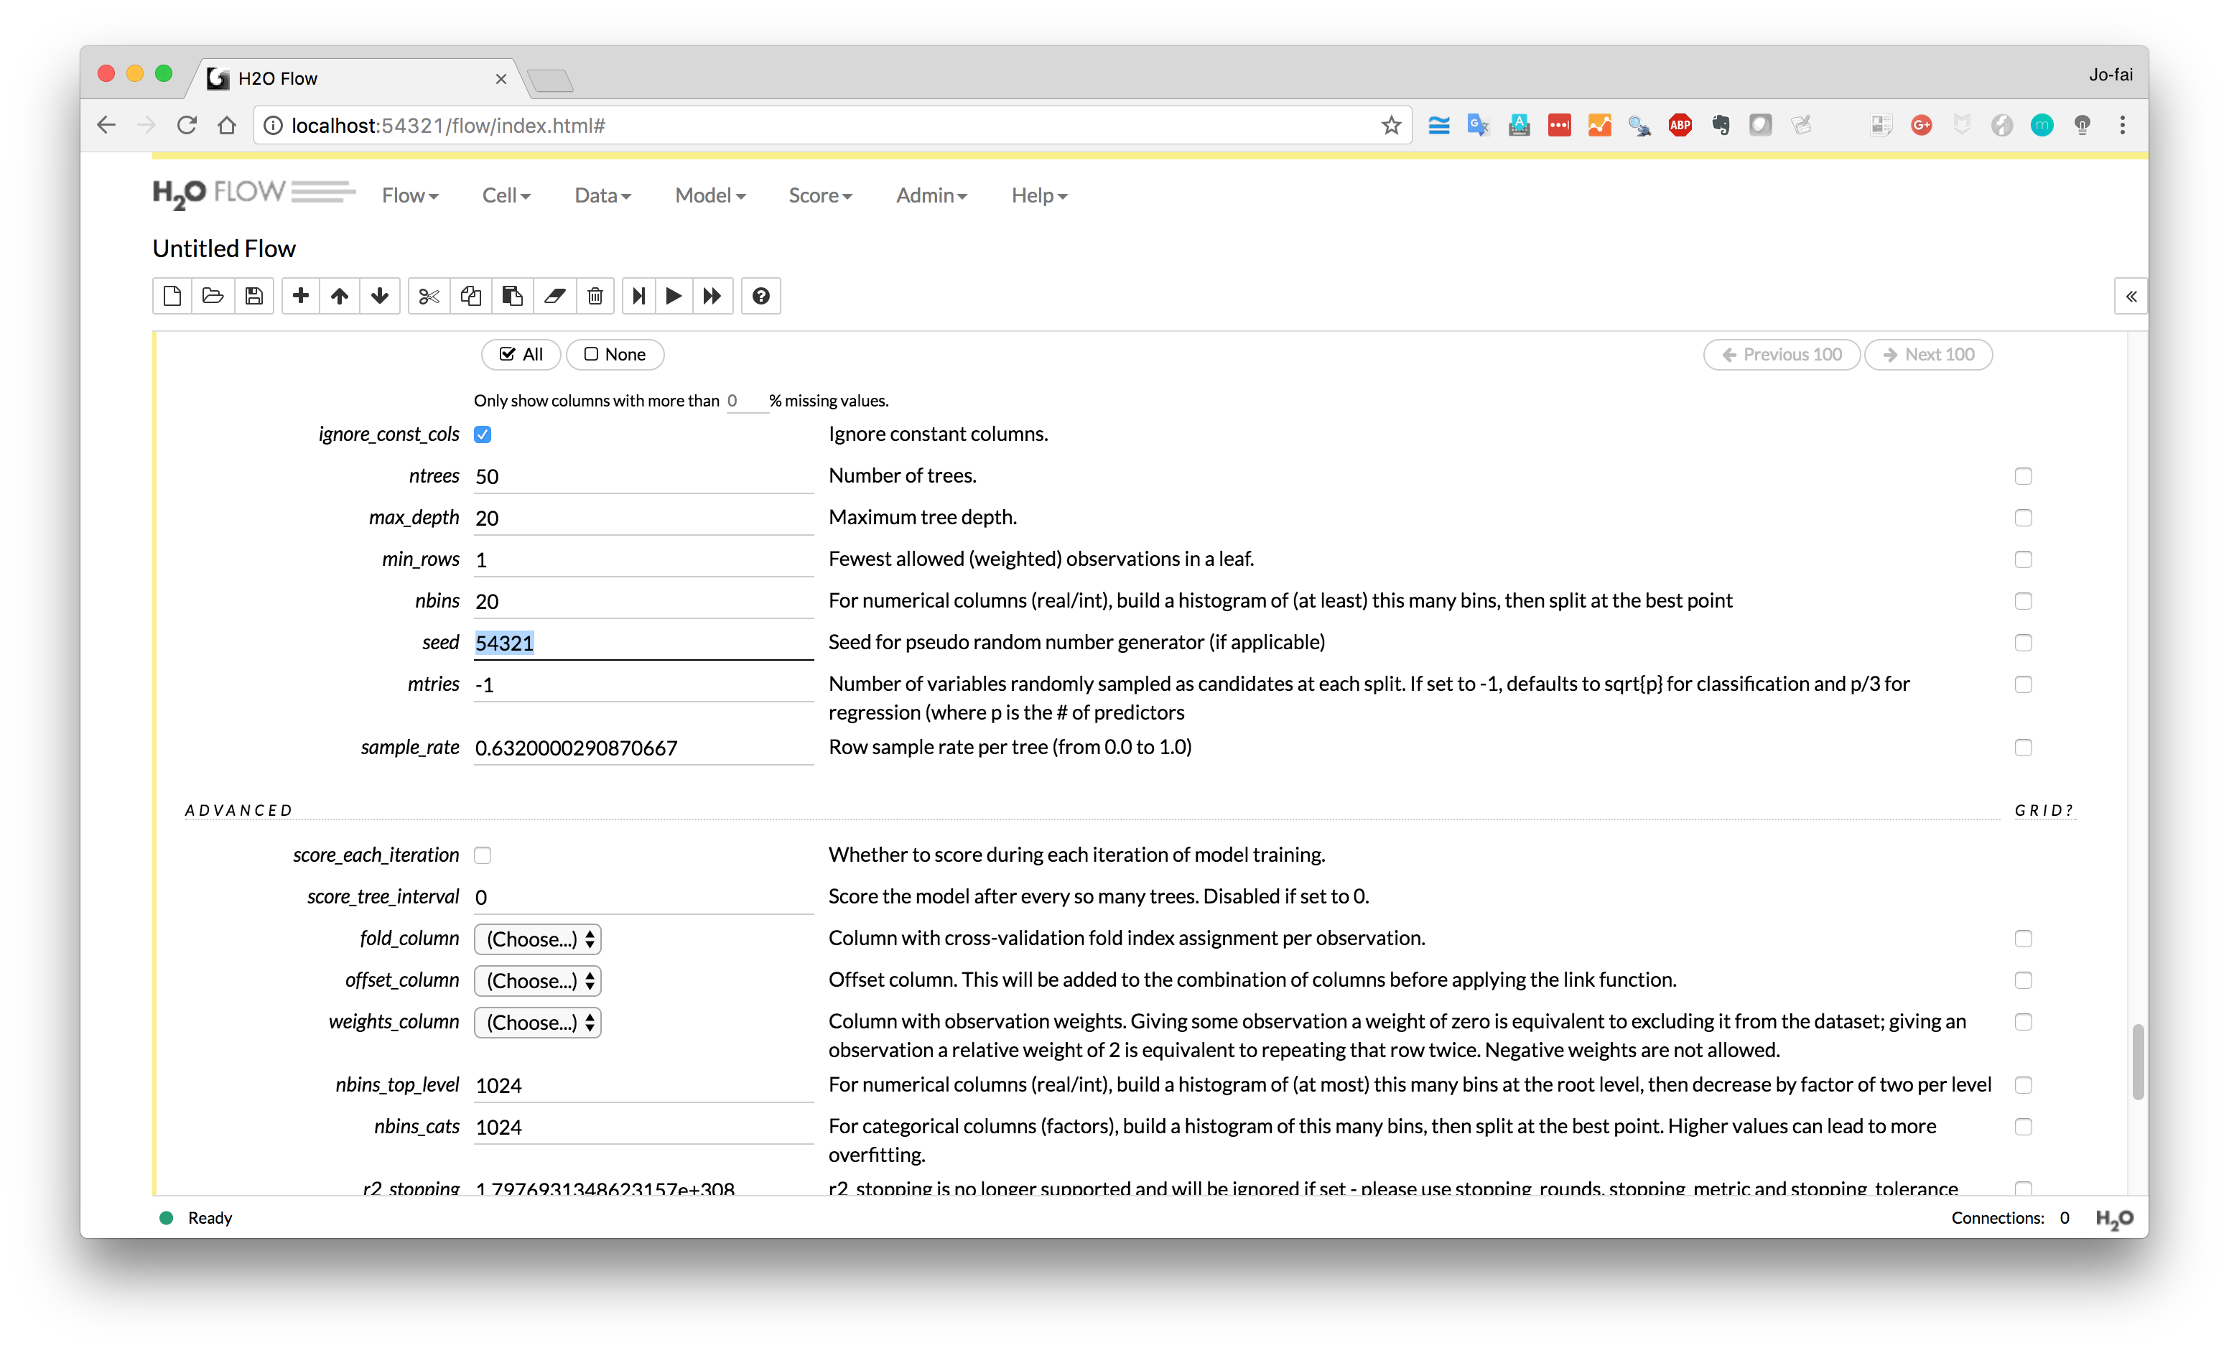
Enter a seed number
(if you want to reproduce your results in future)

Slide 25
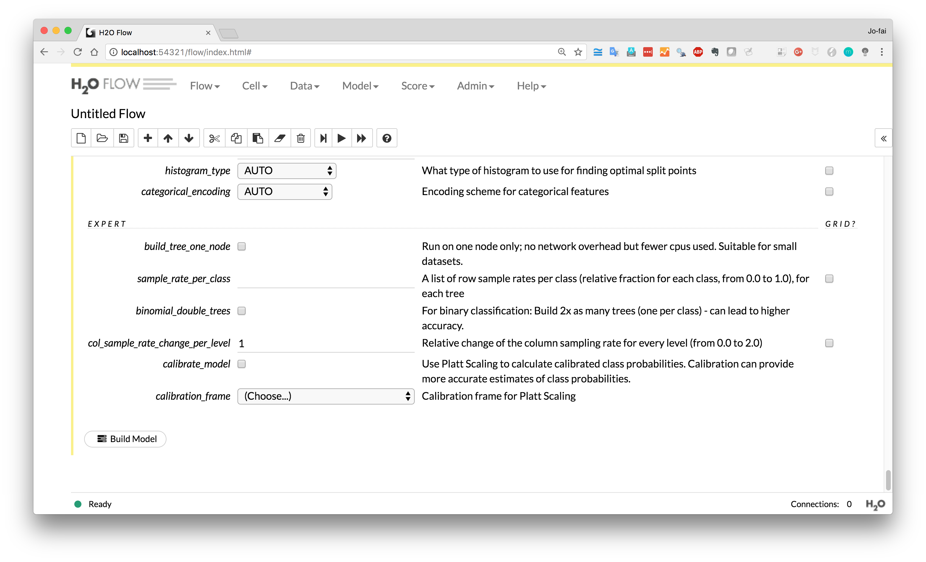
Scroll down and click
“Build Model”

Slide 26
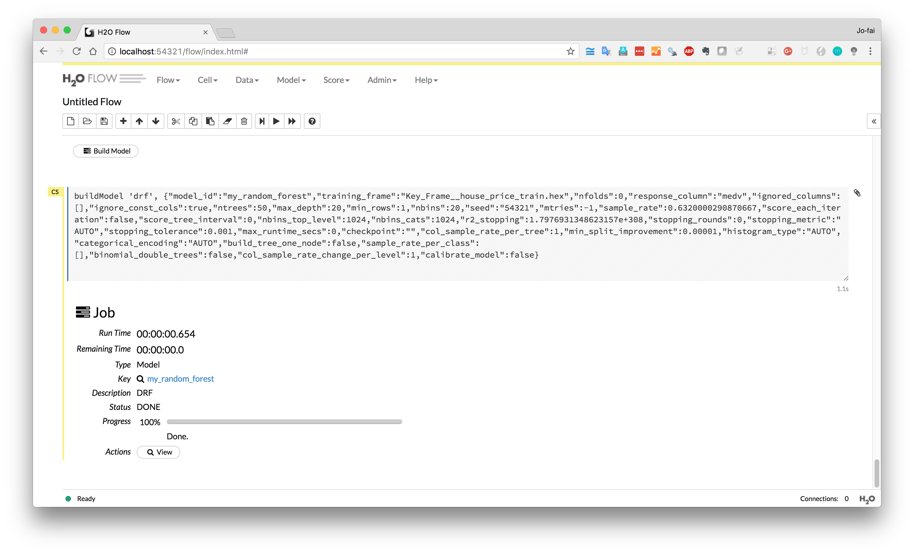
View the model

Slide 27
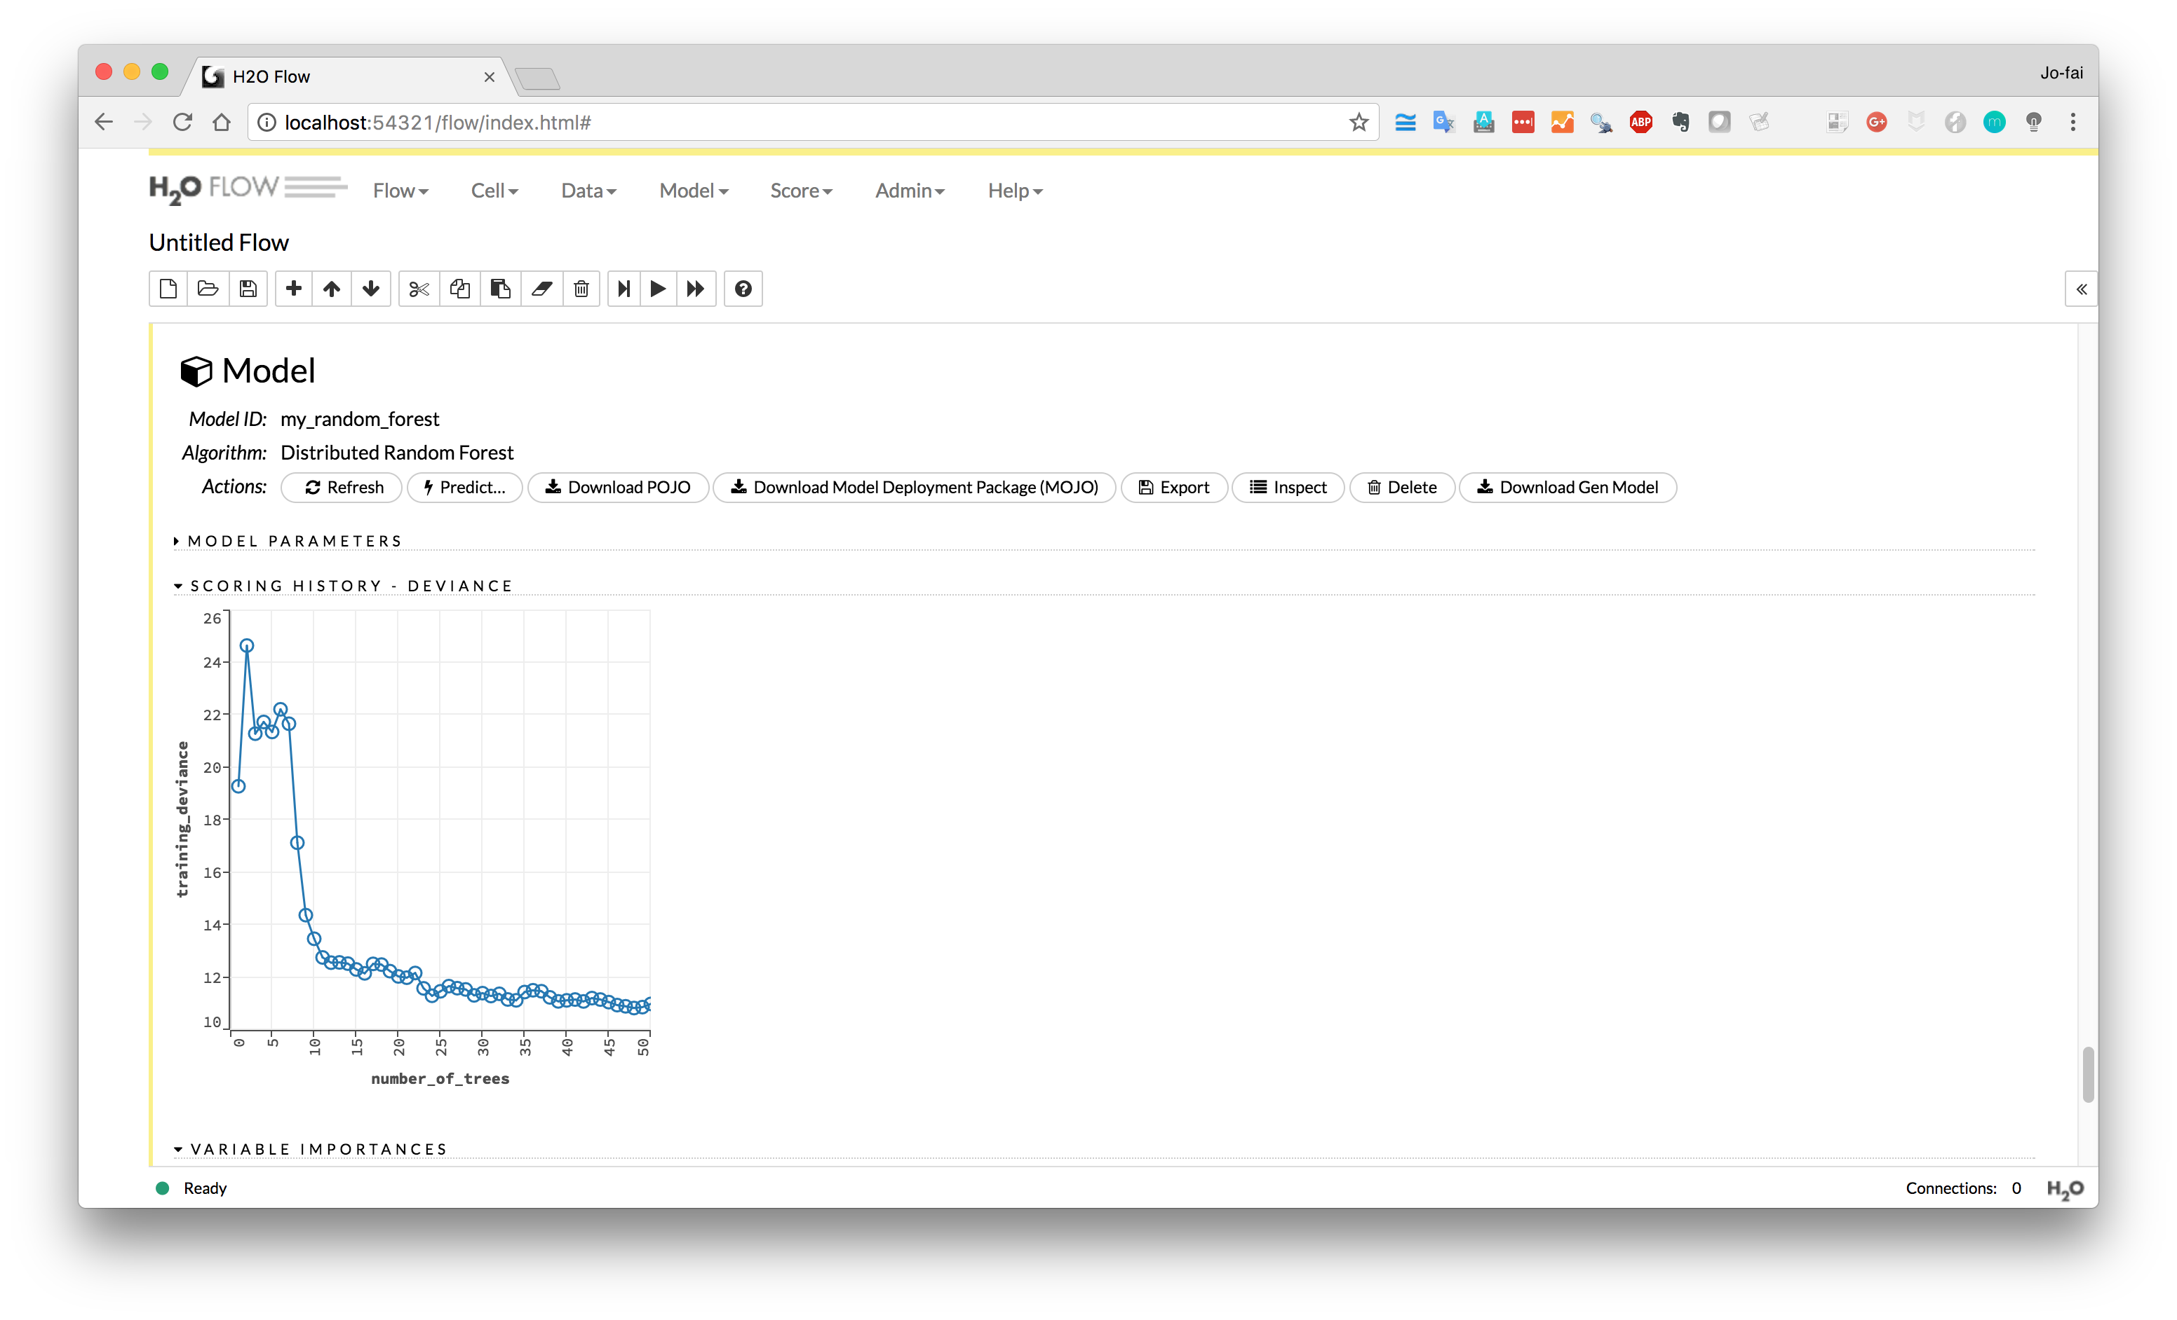
Performance metric
Deviance
(Mean Squared Error)

Slide 28
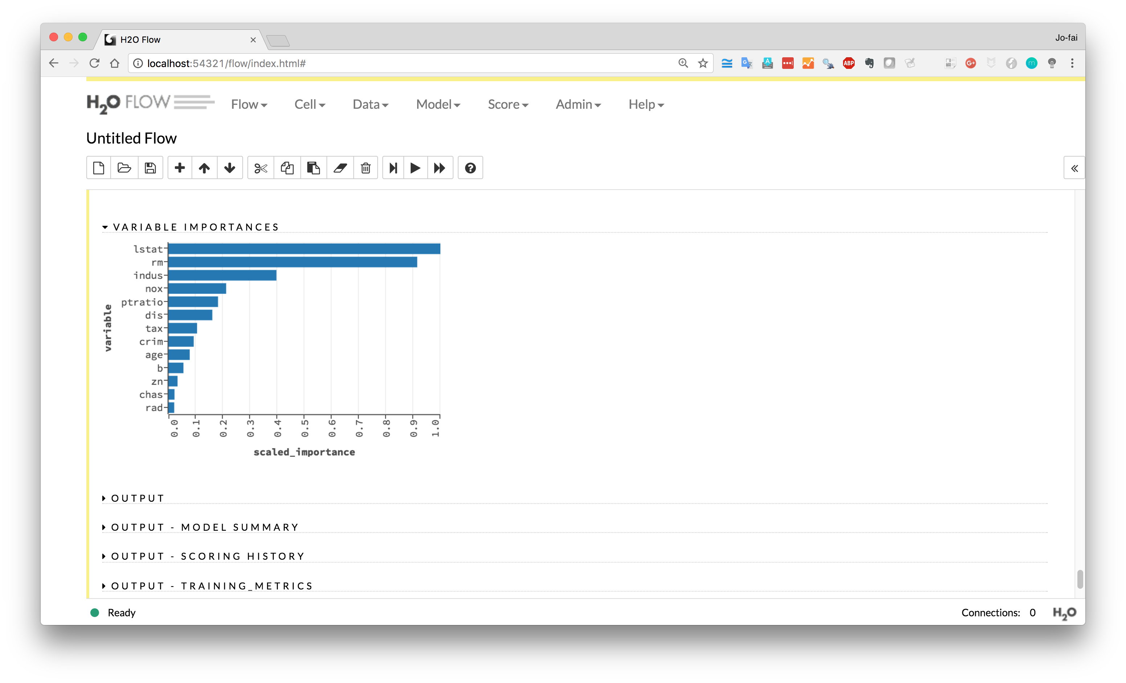
Variable Importance
(it tell you which variables are the key factors)

Slide 29
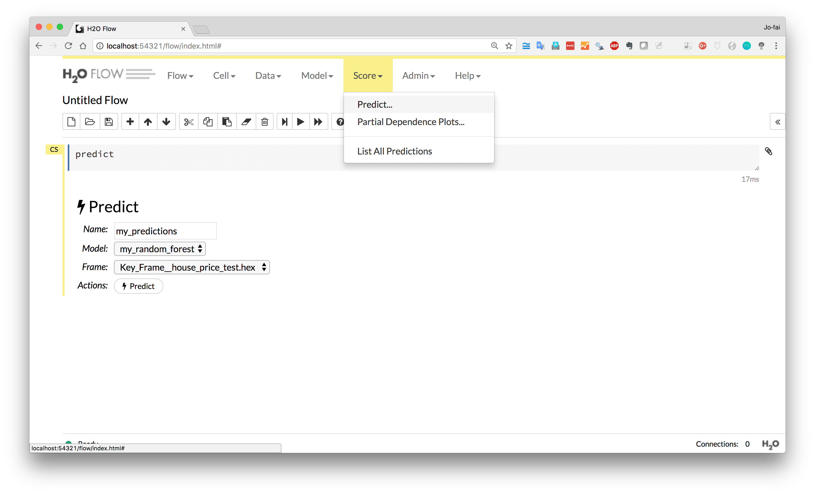
We have a model.
We can now make some predictions on the test dataset.
Score → Predict
Select the model
Select “test” data
Click “Predict”

Slide 30
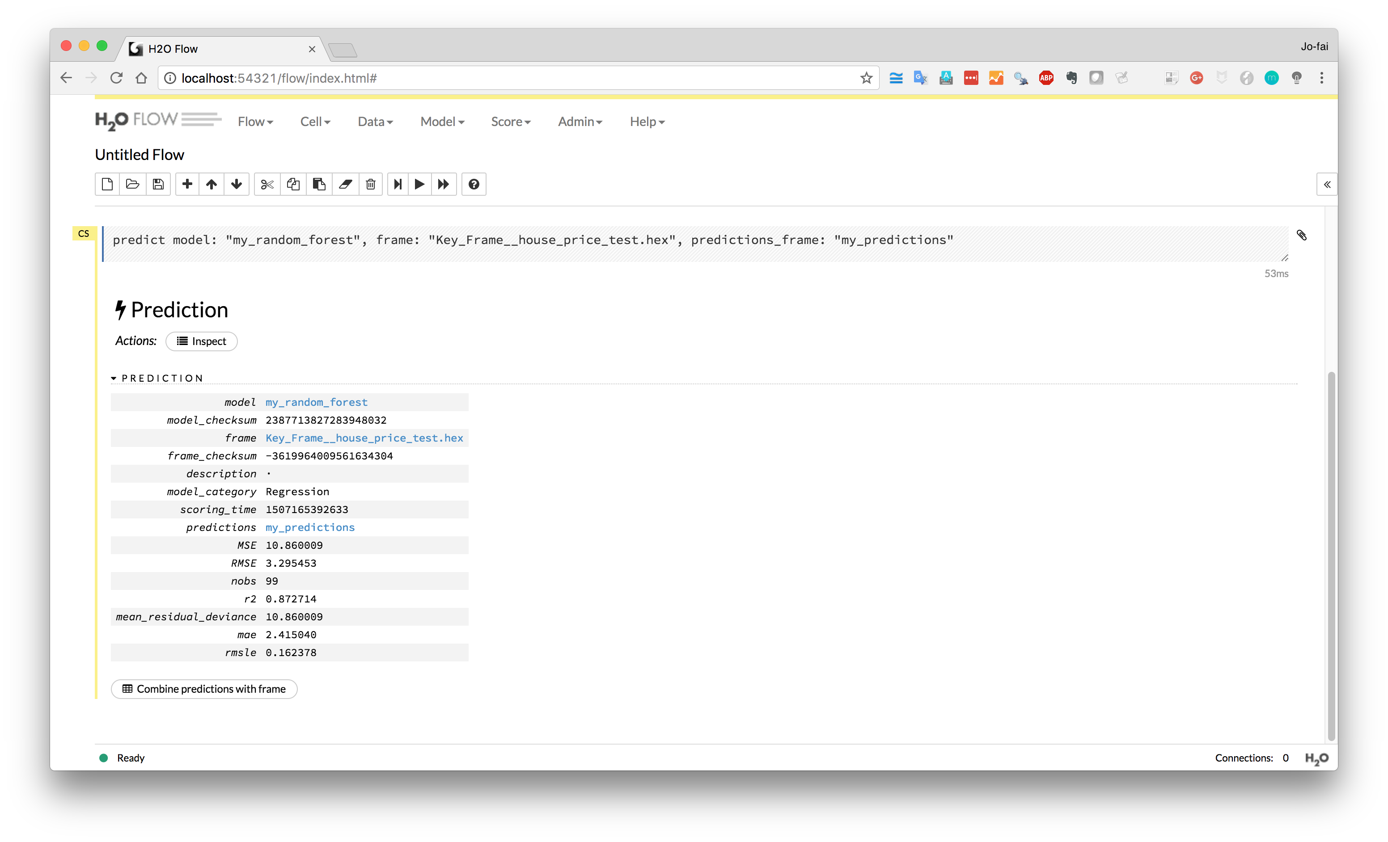
Combine predictions with original test data so we can compare the predictions with ground truth.

Slide 31
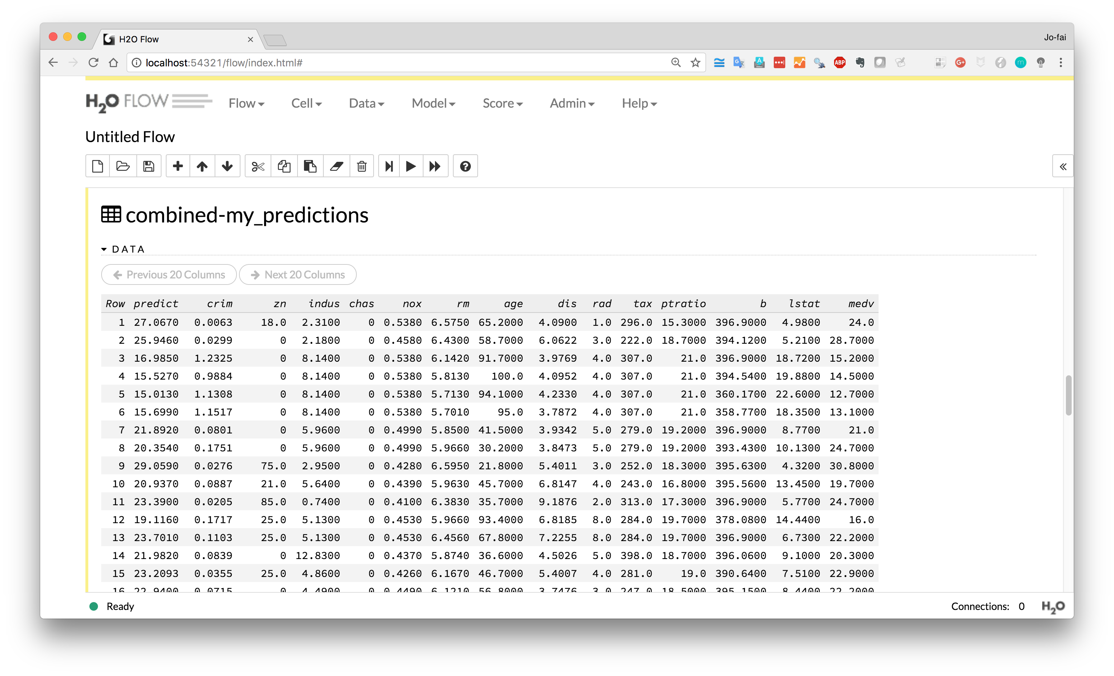
Prediction
Ground Truth

Slide 32
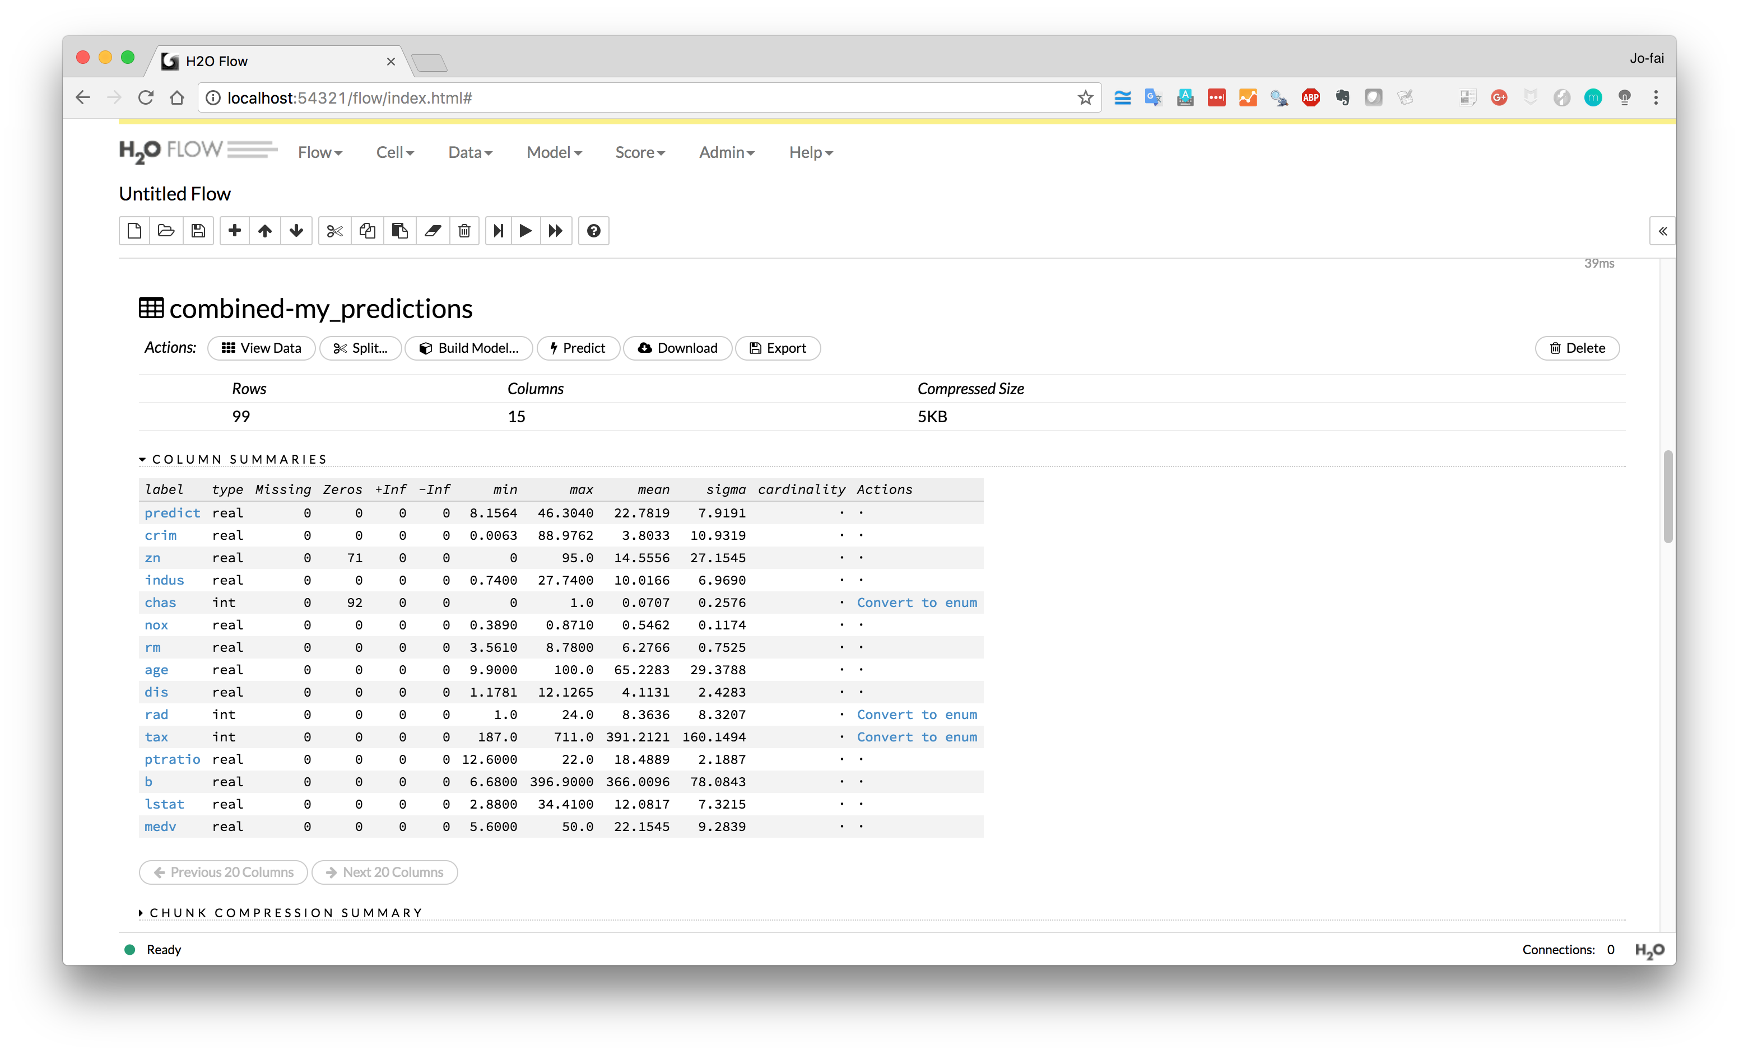
Download the results

Slide 33
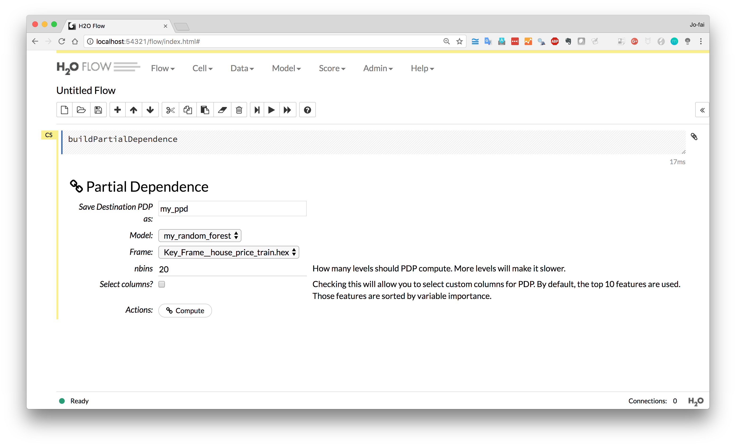
Using Partial Dependence Plots to further explain results

Slide 34
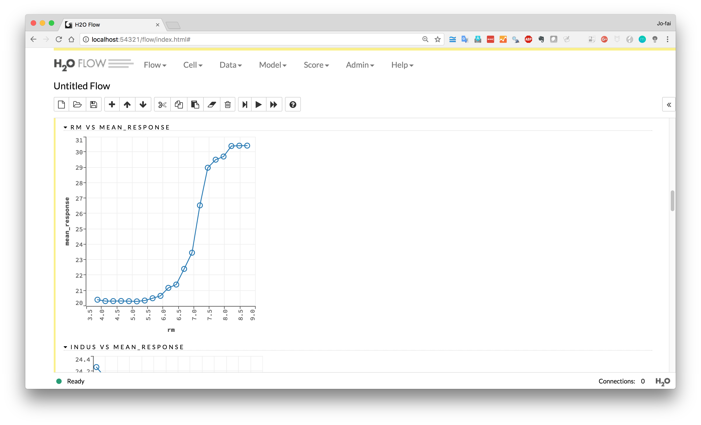
More rooms = higher house value

Slide 35
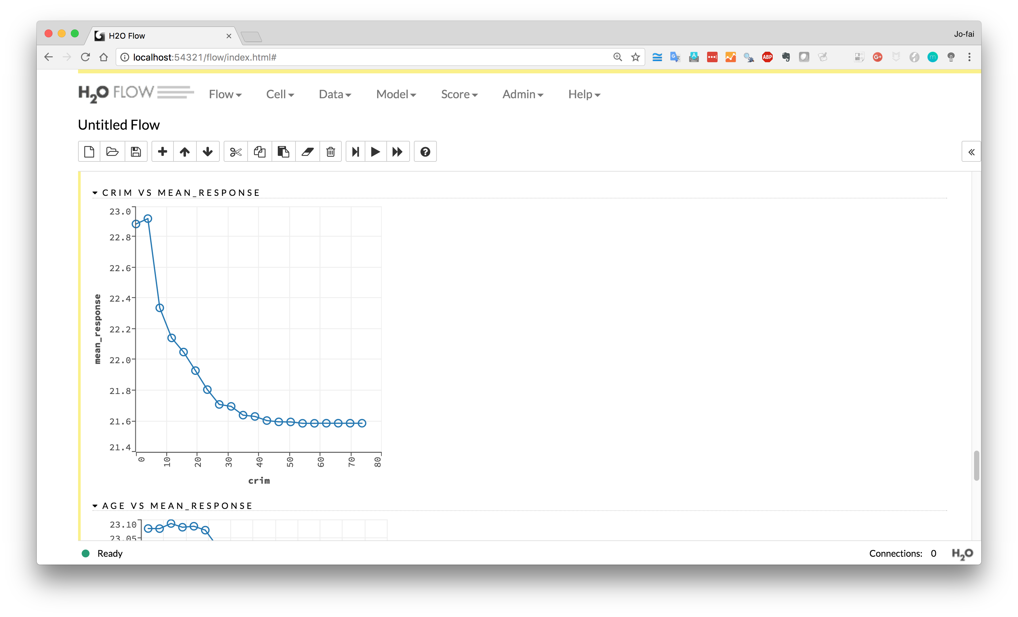
Lower crime rate
= higher house value

